Slide 1
pdrPro and learnPro
System for Airports

Slide 2
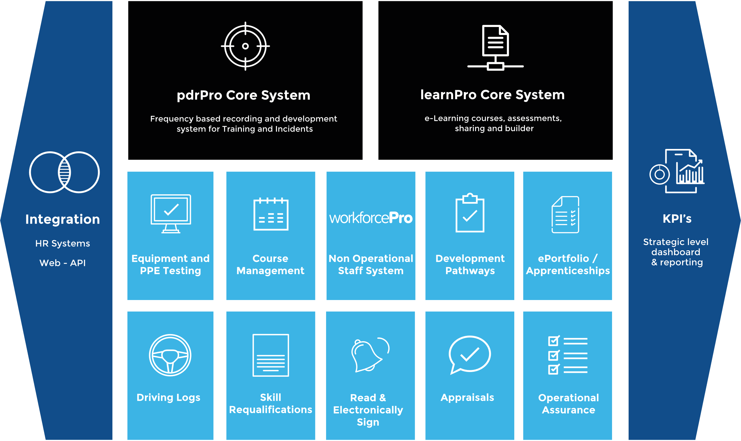
Overview

Slide 3
Core System - Manager
Activity Planner
Frequency based Training Activity Recording
Frequency based incident Activity Recording
Supports Personal Additional Skills & Training
Critical & Non Critical Dev Plans and Reviews
Dual roles, Control Roles, Acting Up, NOS
Driving Logs
Reports

Slide 4
Core System - Manager
Core Add Group Reviews (Managerial Sign off)
Add Group Training Instance
Add Incident
Personnel Management
Reports

Slide 5
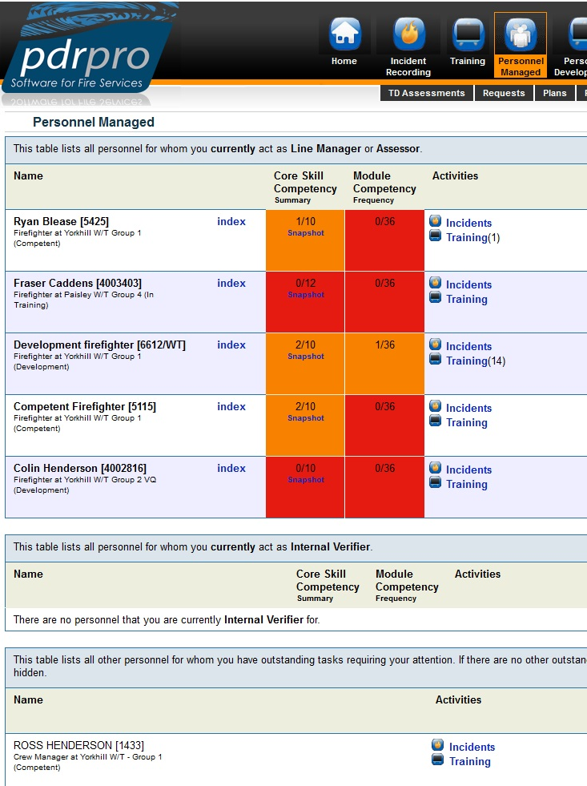
Core System - Manager
Dedicated Personnel Management Dashboard
Instant access to direct reports , IV personnel and personnel you have managed

Slide 6
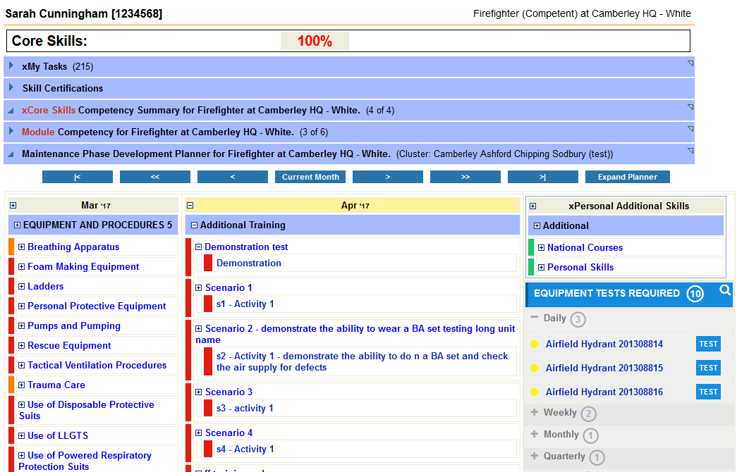
Equipment Testing
Perform required tests directly from planner
Daily, Weekly, Monthly, Quarterly, Yearly
Supports Standard & PPE Tests
Testing can contribute to training activities
Notification messages sent to managers for failed tests
Displays OTR Equipment

Slide 7
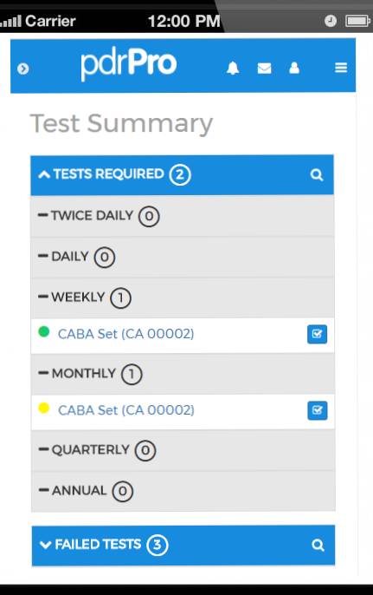
Mobile - Equipment Testing
Add tests directly from mobile
Daily, Weekly, Monthly, Quarterly, Yearly
Includes PPE
Testing can contribute to training activities

Slide 9
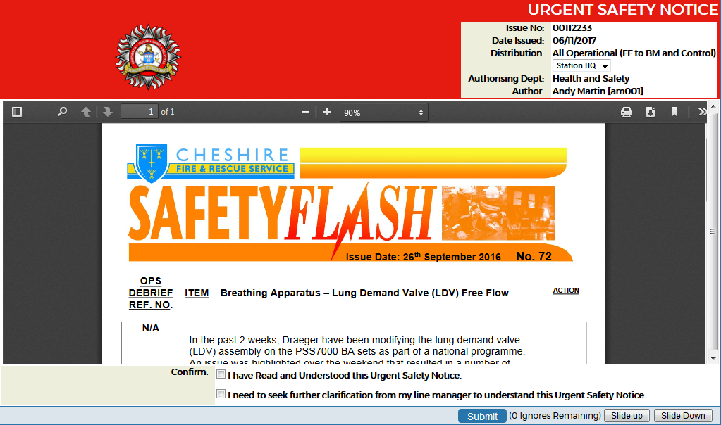
Electronic Read and Sign
Create and Issue all types of notices, Eg: Urgent Safety, Ops Alerts.
Read and Sign Functionality
Send to individuals, groups or all
Supports Document links
Attach PDF document to notices
Report on personnel who have read and not read notices

Slide 10
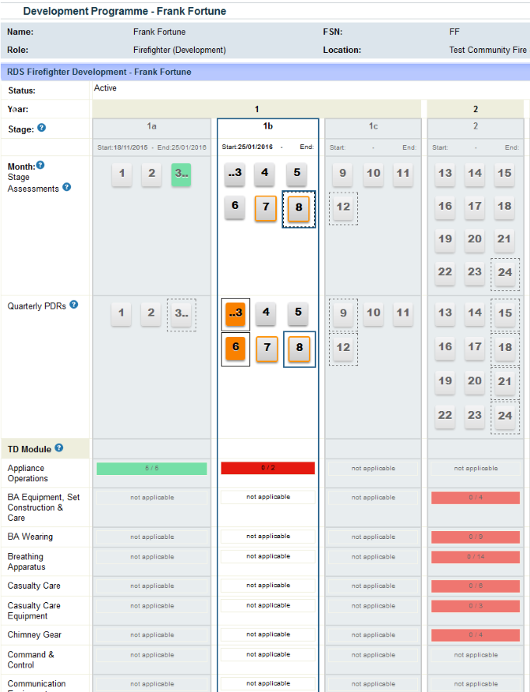
Development Programe
Fully Customisable Templates:
Foundation Stage
Return to work
RDS
Wholetime
Senior Roles
Skills for Justice
Supports Attachments

Slide 11
Certifications
Manage Re-Certification Process
3 Tier Certification Process:
Operators
Operator Assessors
Assess Assessors
Allow Certificate / Assessment Uploads
Integrates into the homepage

Slide 12
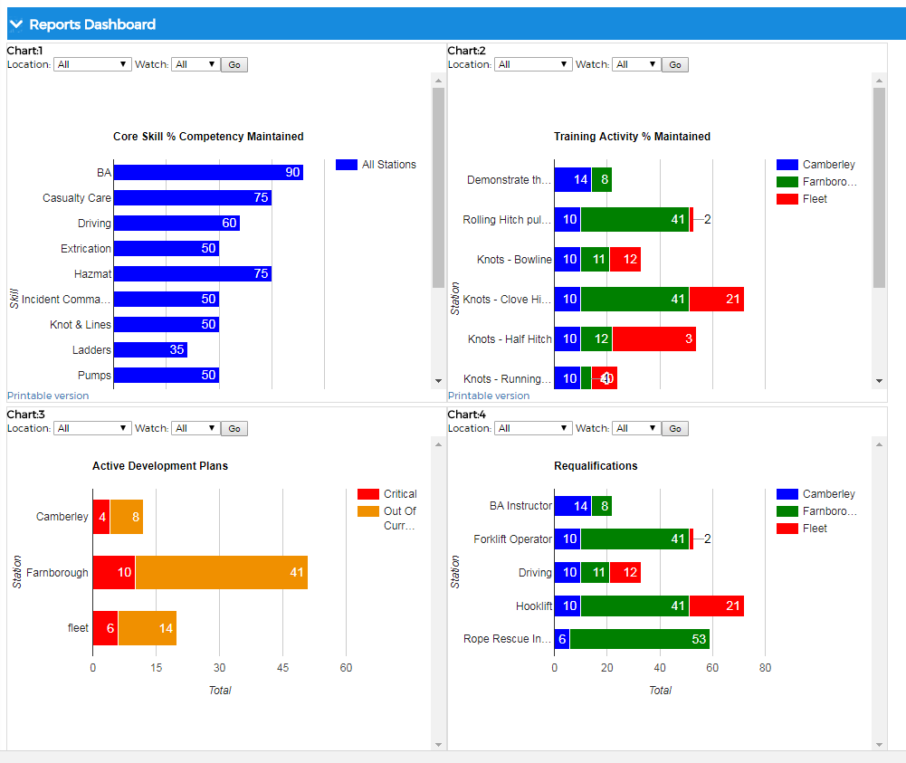

Slide 13
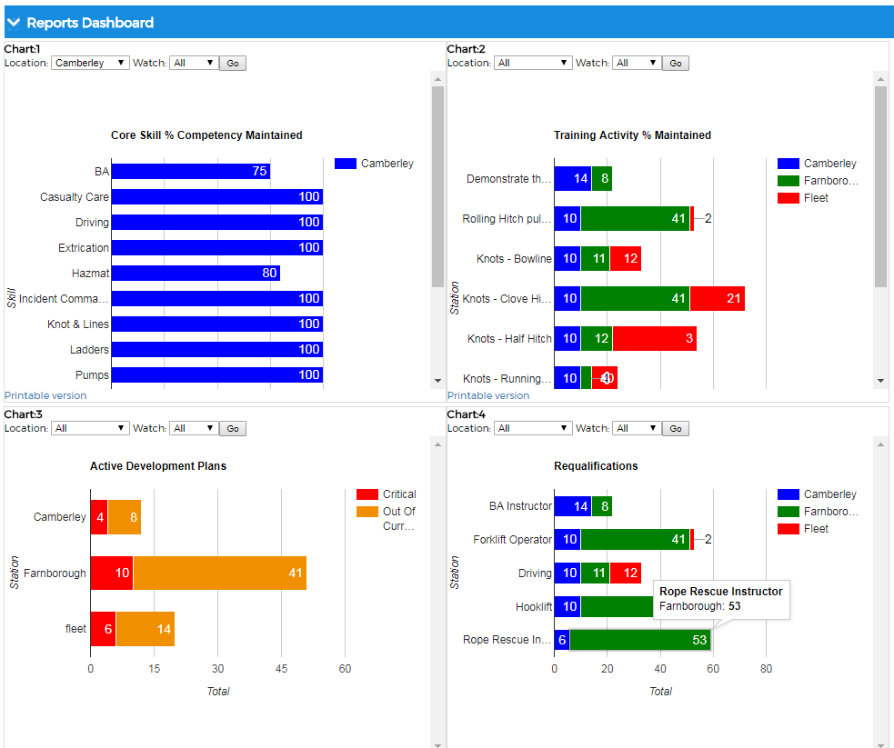

Slide 14
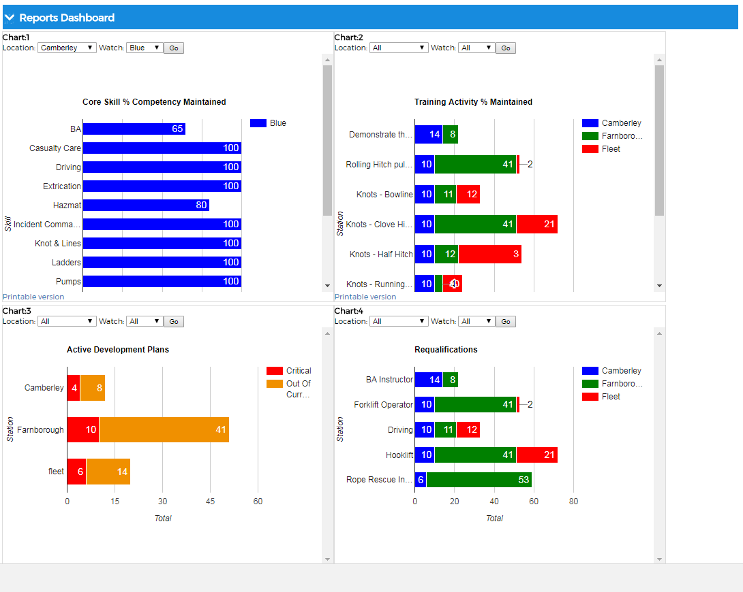

Slide 15
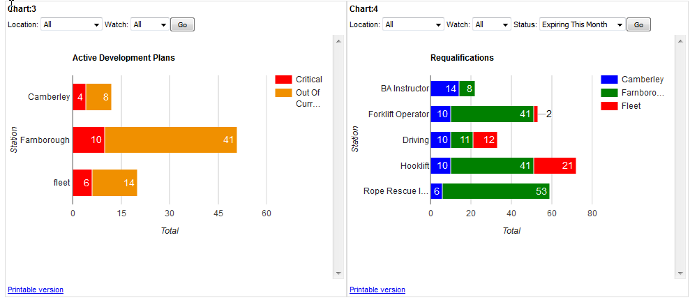
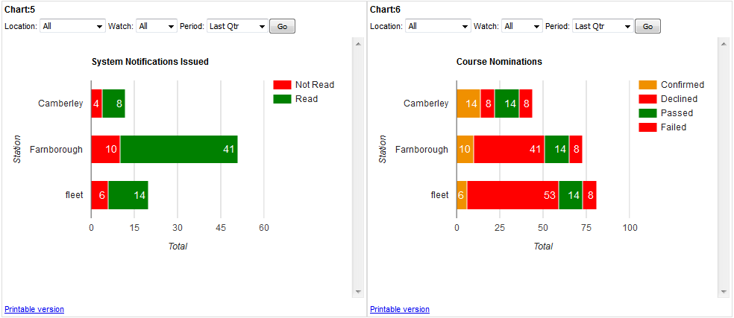

Slide 16
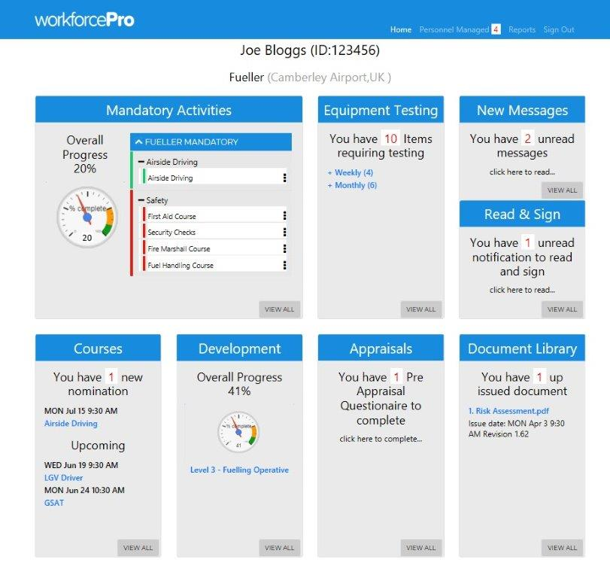
Non-Operational Staff Dashboard

Slide 17
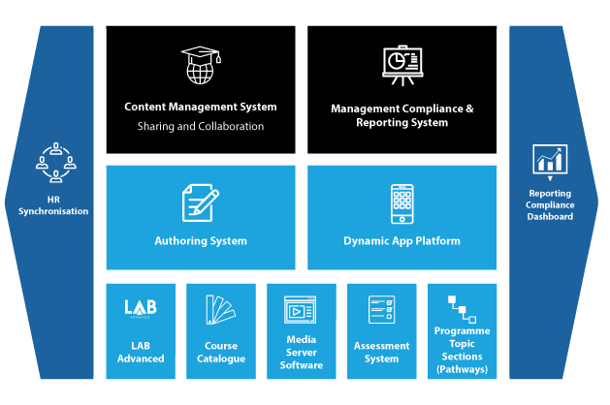
learnPro Overview

Slide 18
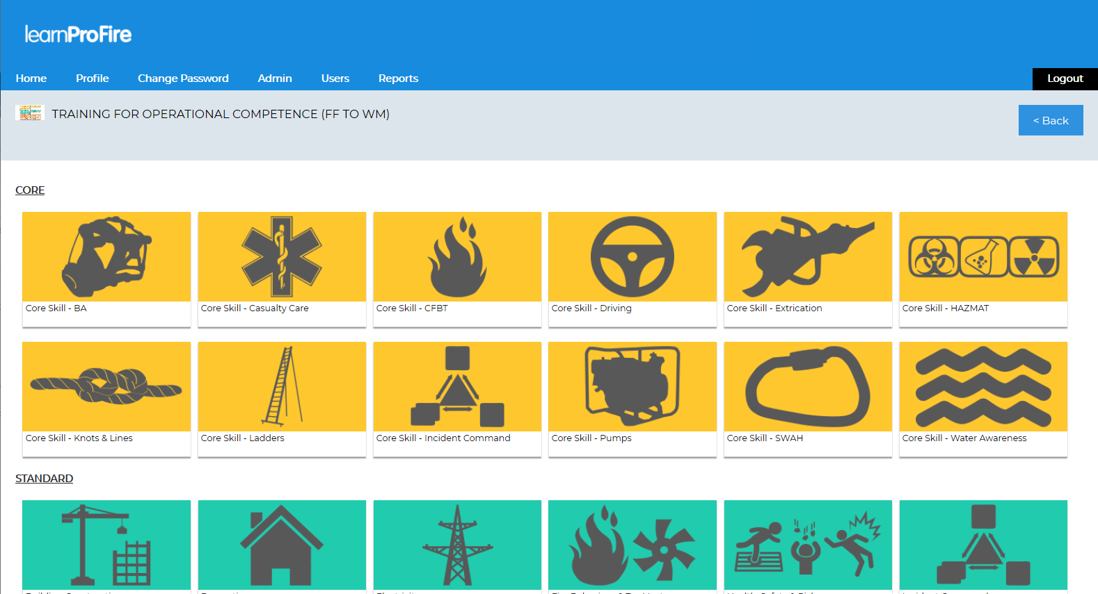
Learning Management System
The LMS is Bespoke system designed specifically for the Fire
Allows comprehensive management and distribution of learning including reporting to show compliance, assessment scores, and completion dates of learning. It handles programmes and pathways of learning together with a revalidation system
It has built in authoring tools to create separate assessments, advanced e-learning modules that are mobile enabled, video streaming and sharing capability regionally and Nationally

Slide 19
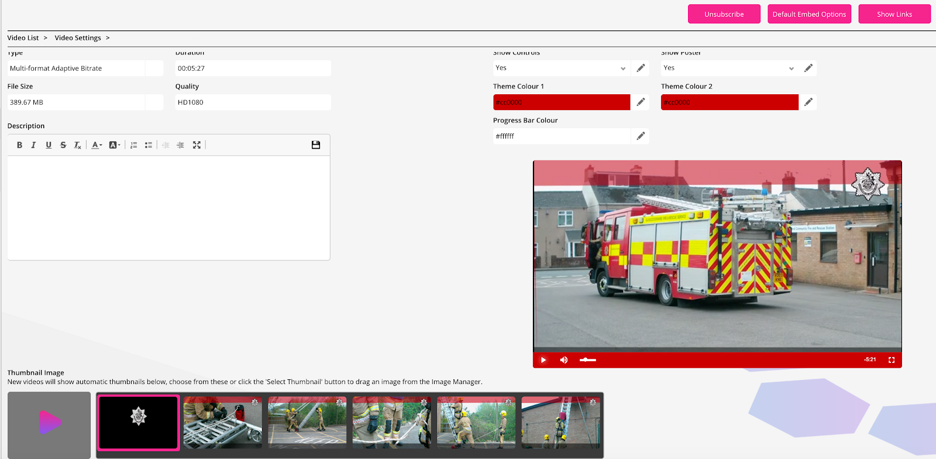
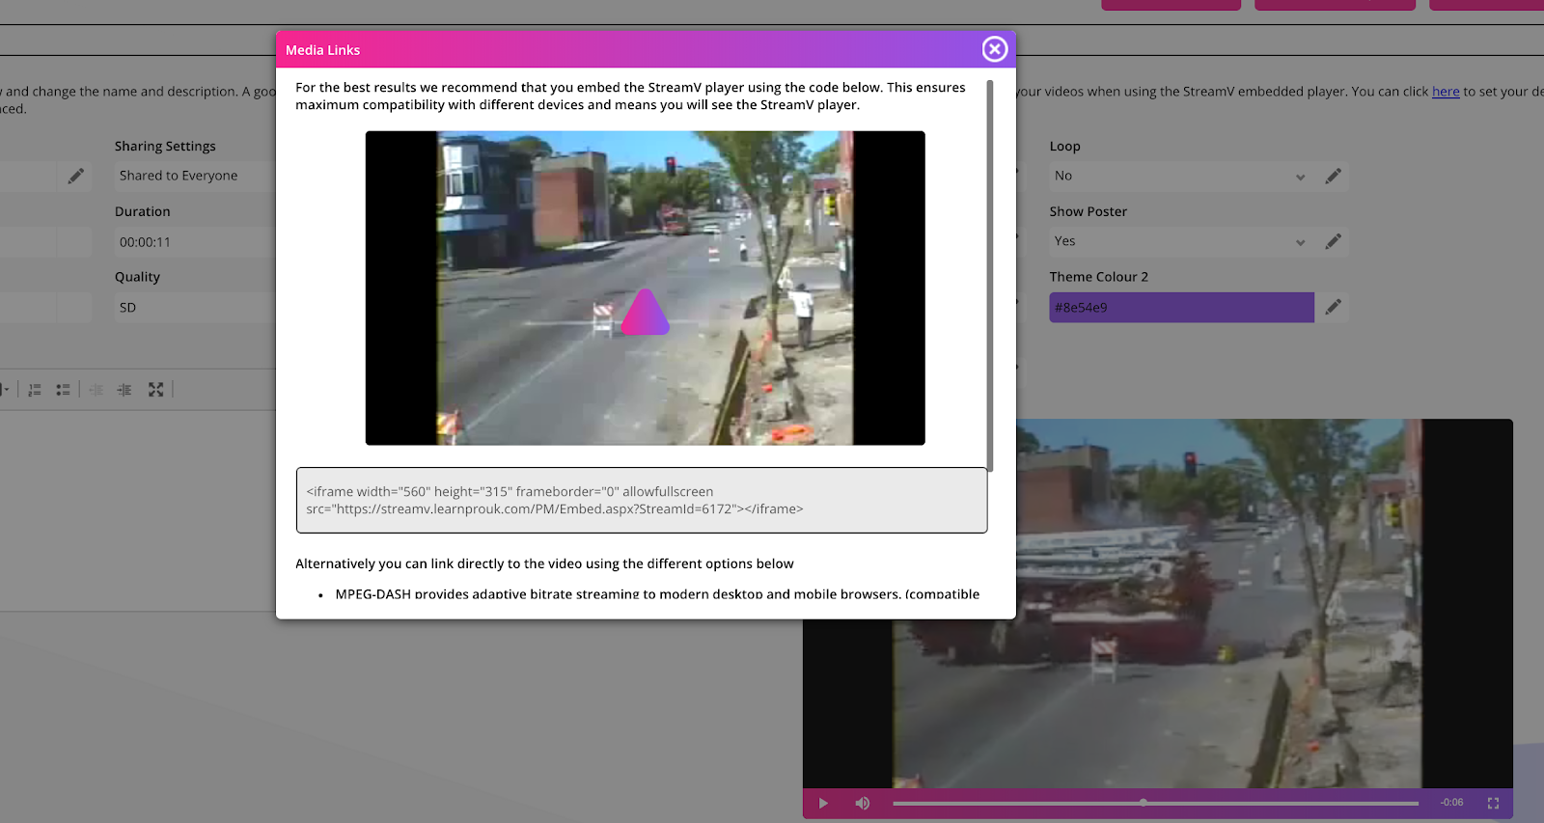
Widest Selection of Fire Related e-Learning Course and Assessments
Core Skill Videos, Courses and Assessments
Firefighter Development Programme Courses and Assessments
Management and Mandatory Courses for all Staff
Convert your PowerPoints into e-Learning Courses - Conversion tool
Every Subject Covered from Incident Command to BA

Slide 20
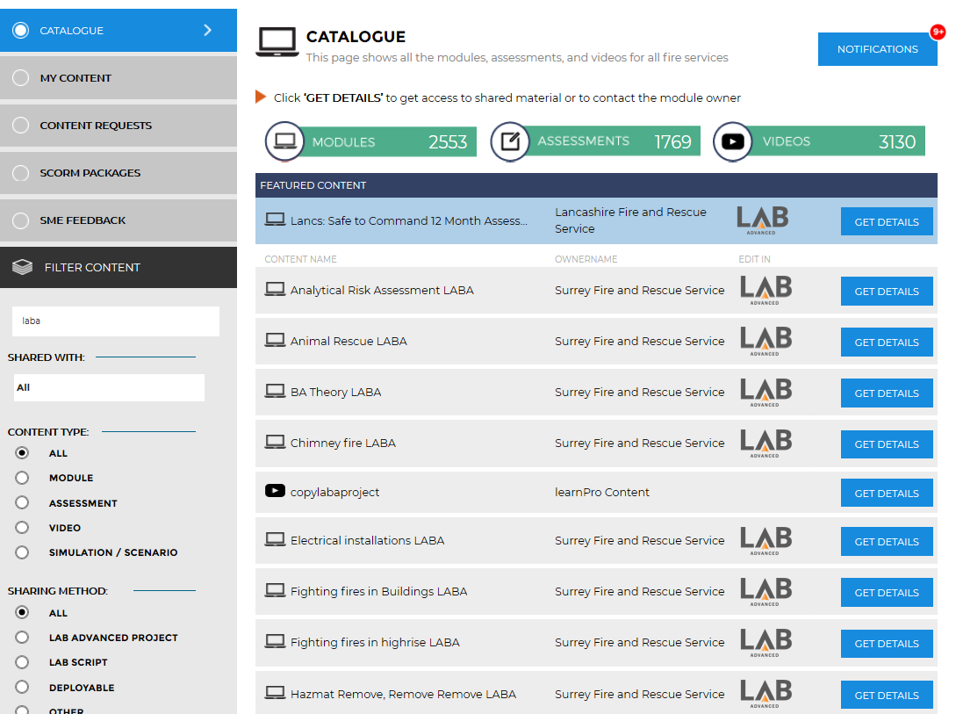
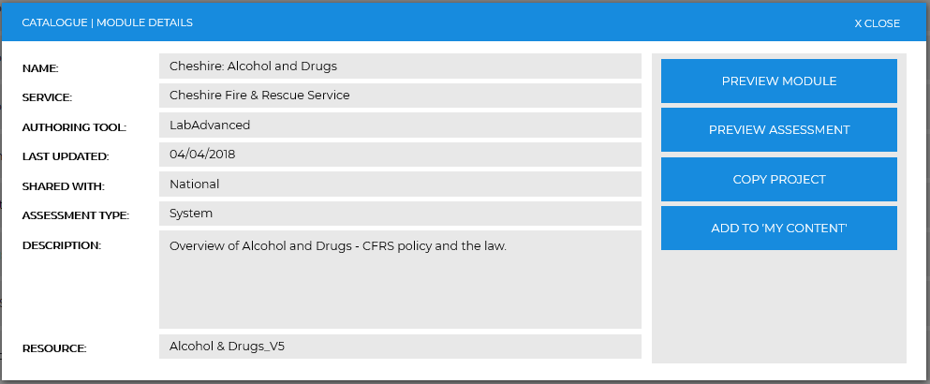
Content Management System
FRS specific system for sharing content
32 services share content - share video, courses and assessments
Totally integrated into PDRpro
Form groups to share specific content and manage version control

Slide 21
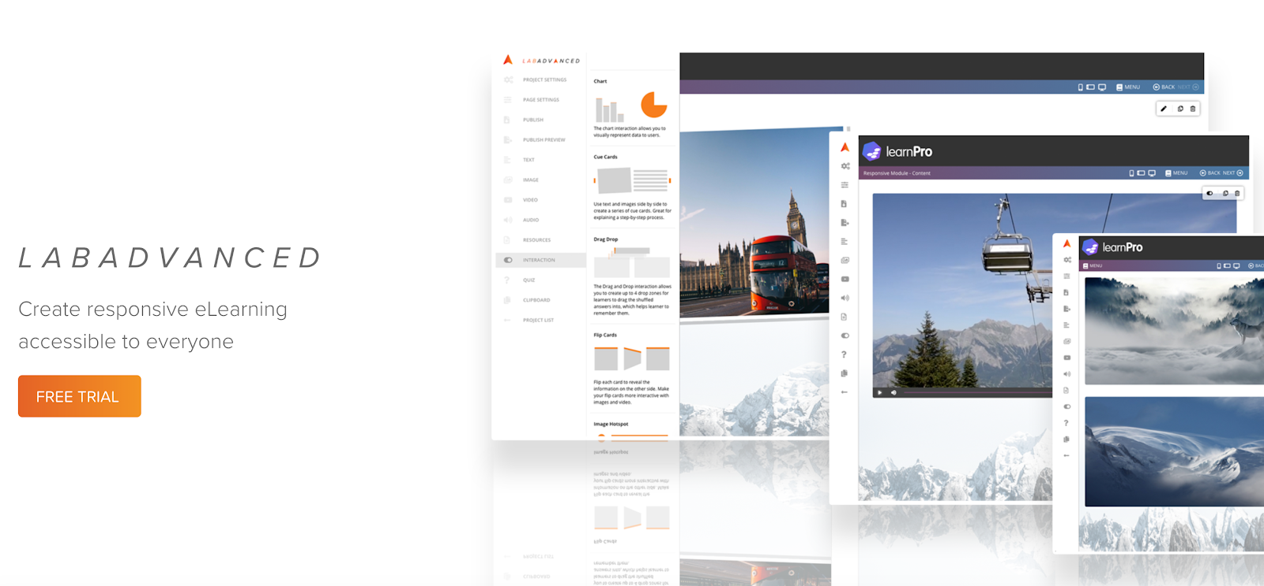
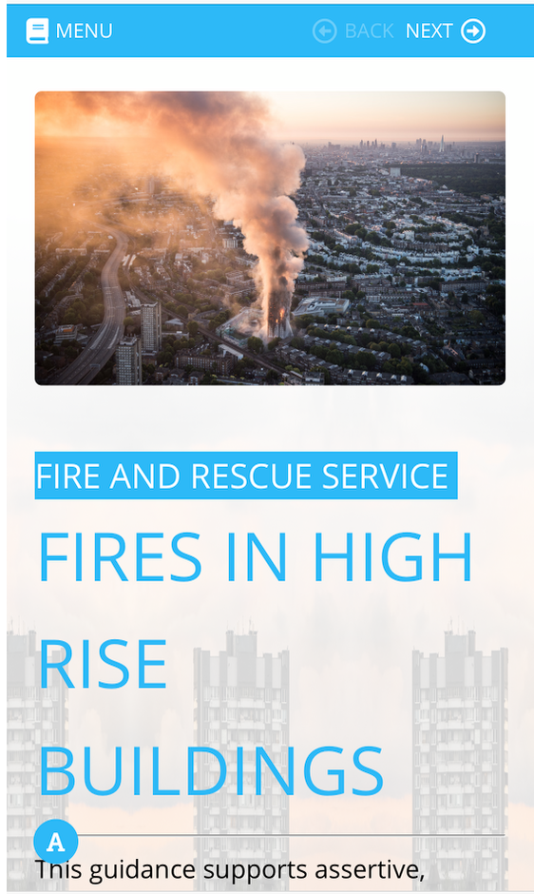
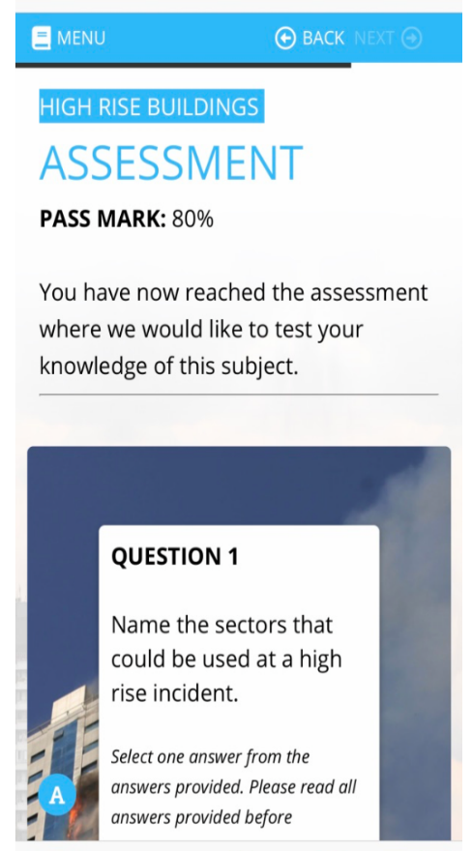
LAB Advanced Authoring System
Create Responsive e-learning for any device - Authoring your own courses
Lab advanced; Inbuilt authoring tool, online for ease of use, sharing and ease of customising shared content
Manage projects, collaborate, build themes, add and manage images, video and interactions
Lab advanced is mobile friendly for Tablets and Phones

Slide 22
Stream V Adaptive Video Streaming System
Embedding video links into any media
Cross Platform streams - HLS and MPEG DASH for an browser or operating system
Easy Video Upload just drag and automatically decodes
Add streamed video

Slide 23
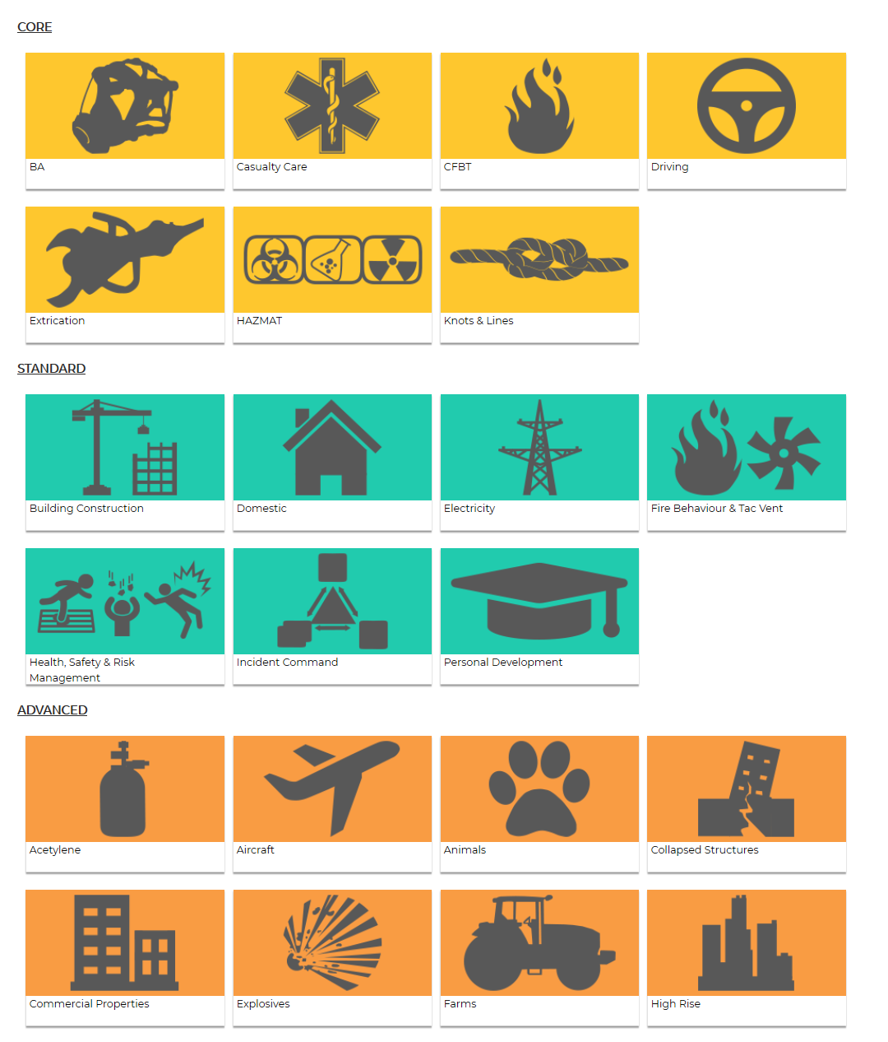
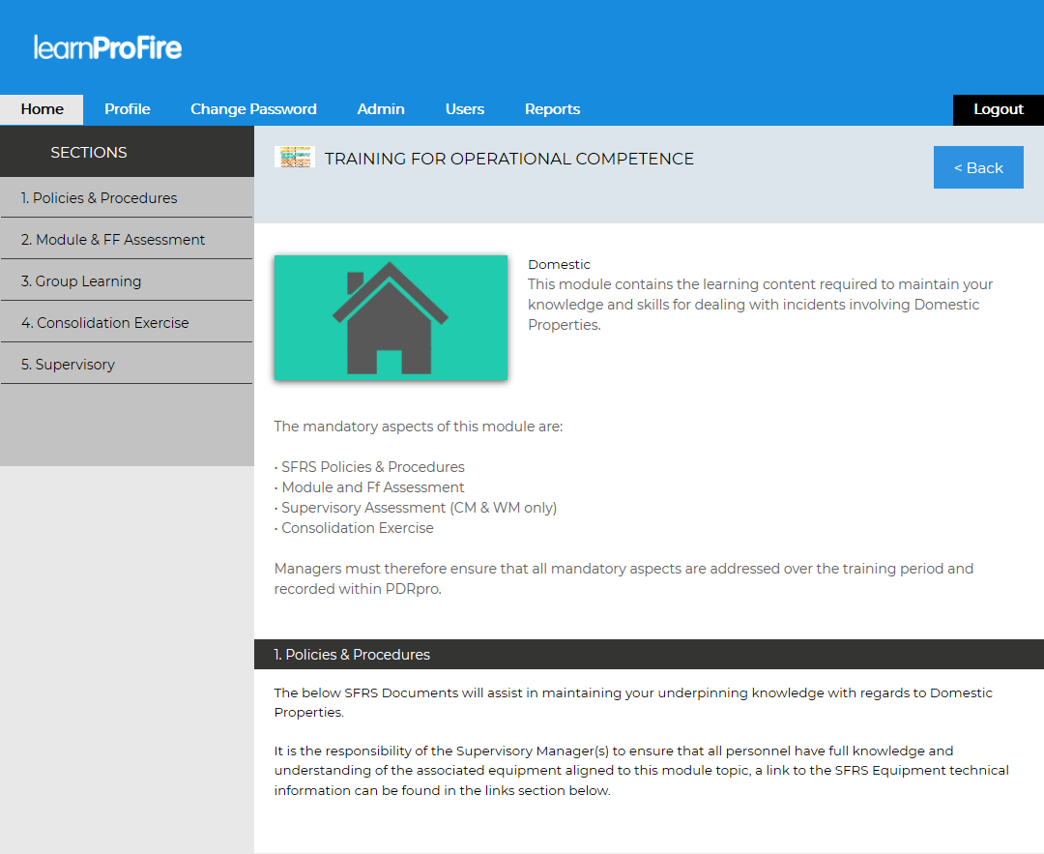
Content Management System
Create programmes of learning with topics and sections and build up your content per page
Easy assembly of a Programme of learning
Attach documents, elearning modules, assessments, links and images
Build pathways of learning for roles
Add streamed video

Slide 24
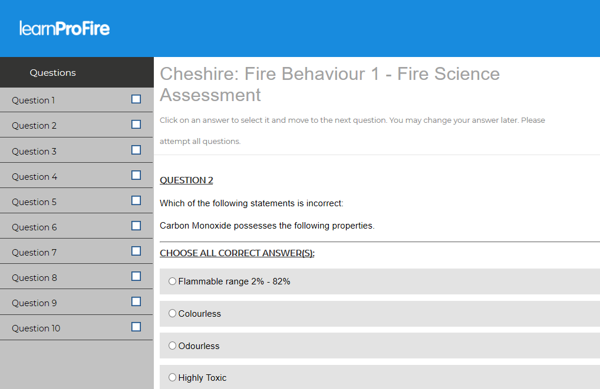
Powerful Assessment System
Create linked assessments or standalone assessment
Build banks of questions and answers and randomise and control order and results
Set expiry and revalidation time for assessments
Build instructor led assessments
Reports correlate with the Station, Watch and Individual to identify compliance at these levels

Slide 25
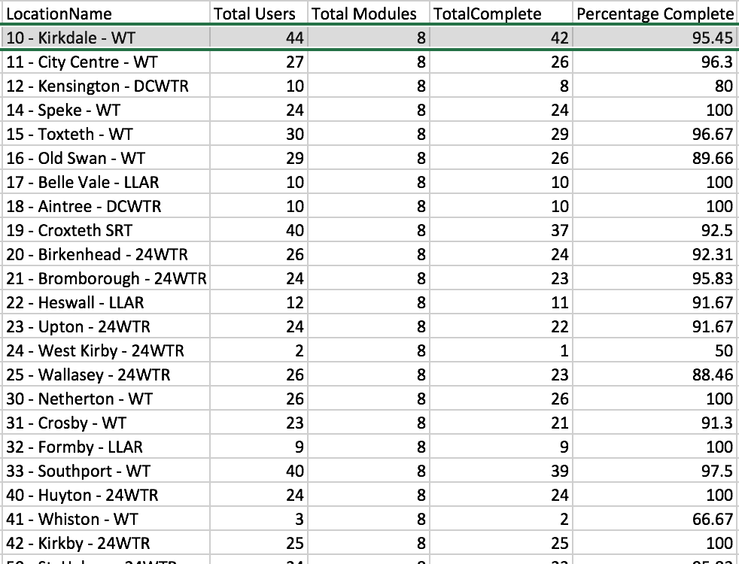
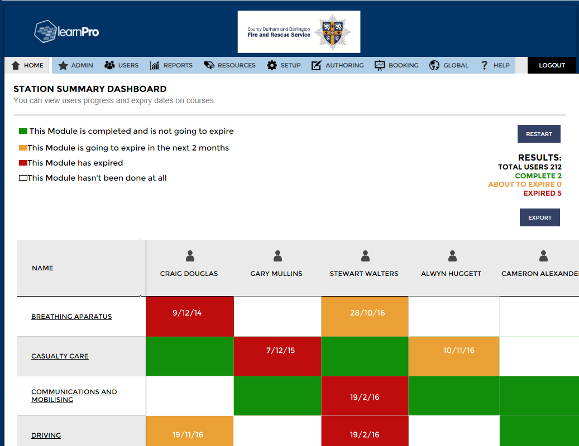
Powerful Compliance Reporting
Dashboard for watch managers with ability for admin to set up each station mandatory training
Revalidation automatically manages expiry and alerts L&D and Line Managers
Wide range of reports
Export and Integrates Reports with HR
Sync software available

Slide 26
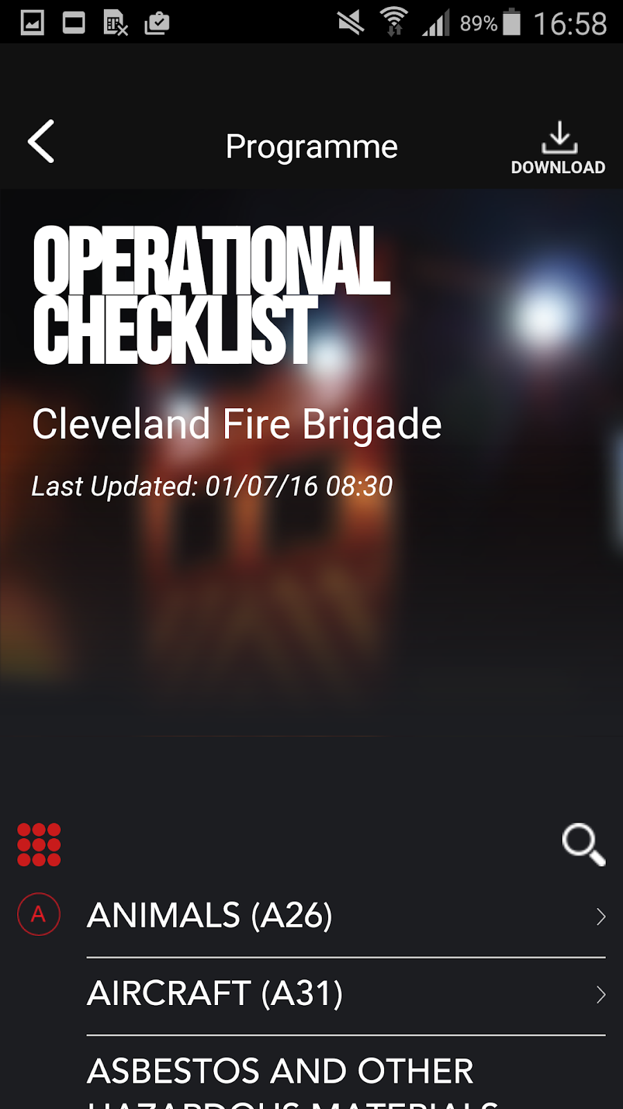
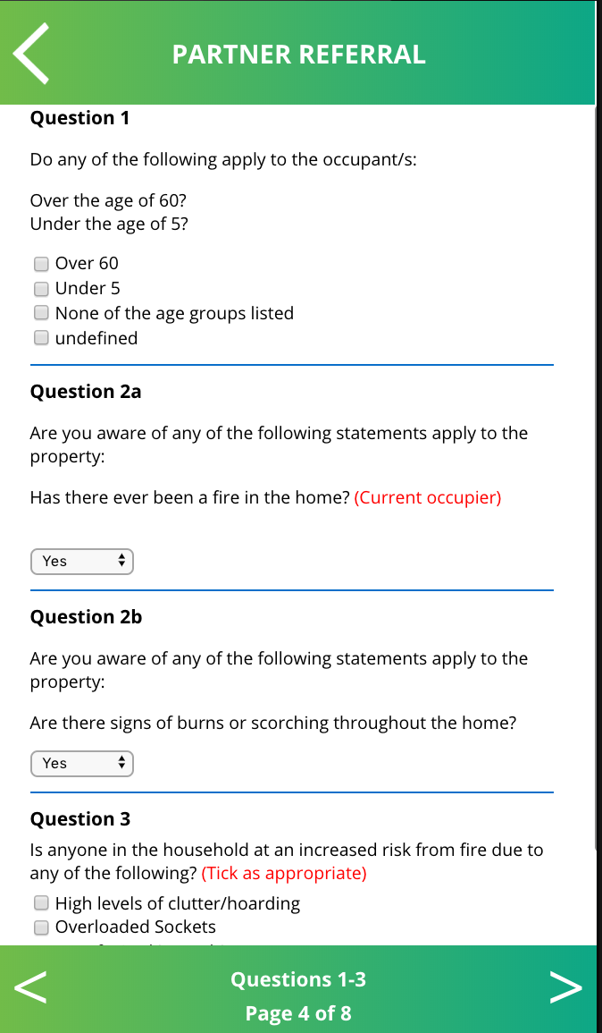
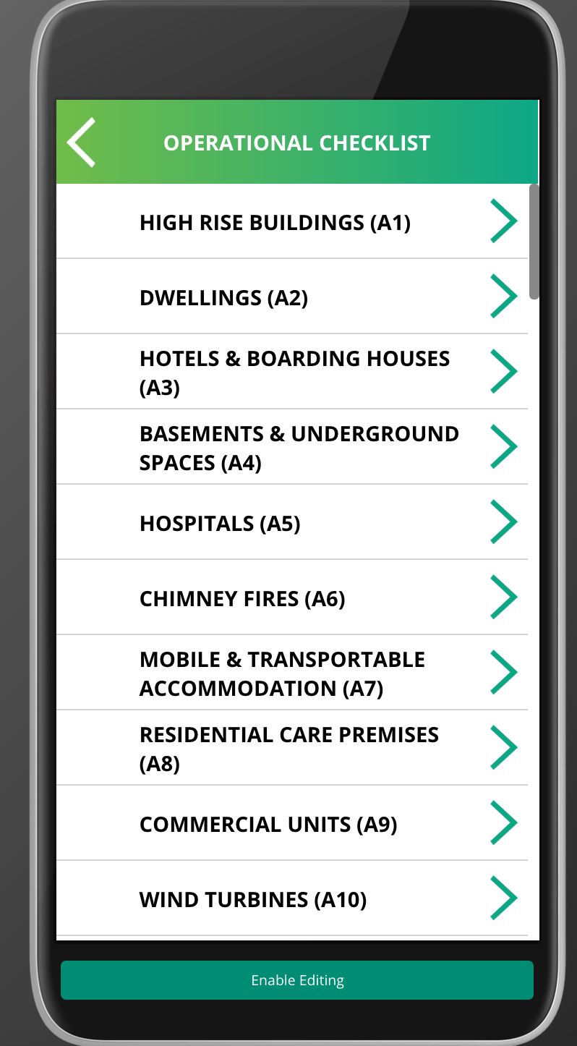
Platforms App and
Authoring System
Create any form or decision tree
Authored via learnPro
Create any Form and Report Back
Add SOPS and images
Add videos from learnPro LMS and stream directly on all devices
Services creating Apps for Safe and Well, Home Visits, Operational Checklists, Incident Monitoring

