Slide 1
System Overview
for Fire and Rescue Services

Slide 2
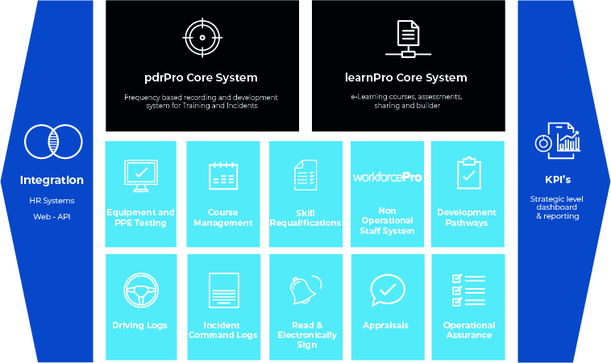
Overview

Slide 3
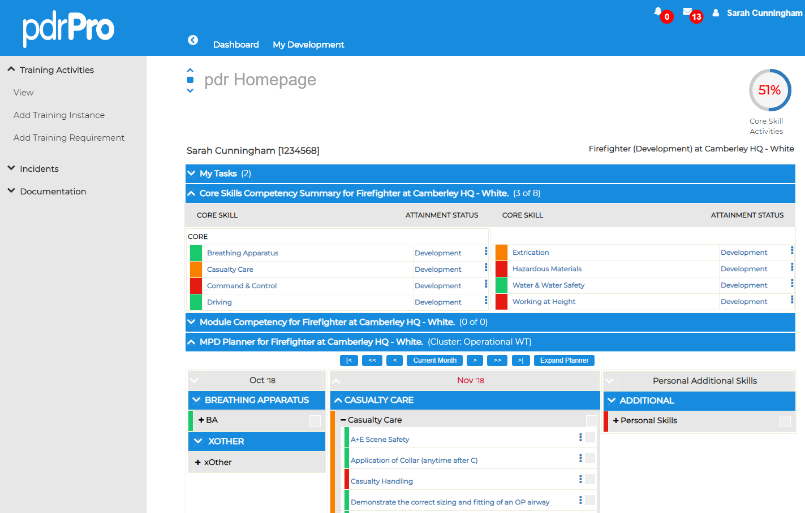
All Operational Roles
pdrPro Dashboard
View frequency based core skills and competency status
View all lower level linked activities spread across activity planner

Slide 4
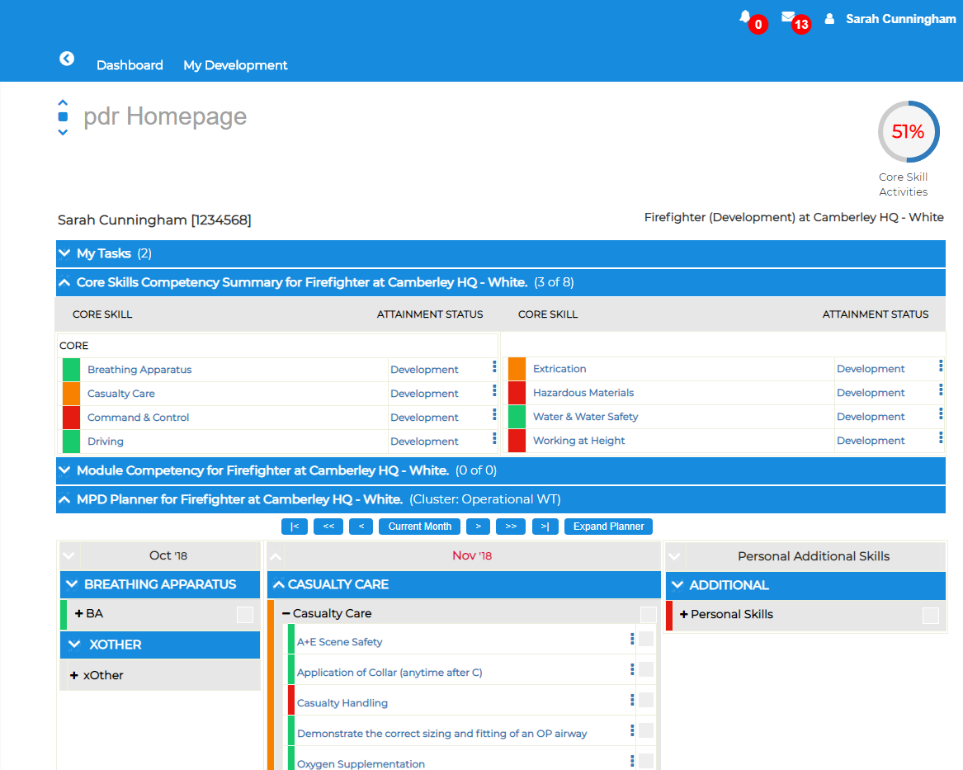
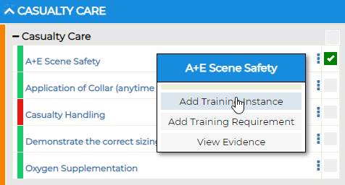
Typical User Journey - Firefighter
Record ad-hoc training event
Select activity / activities from activity planner

Slide 5
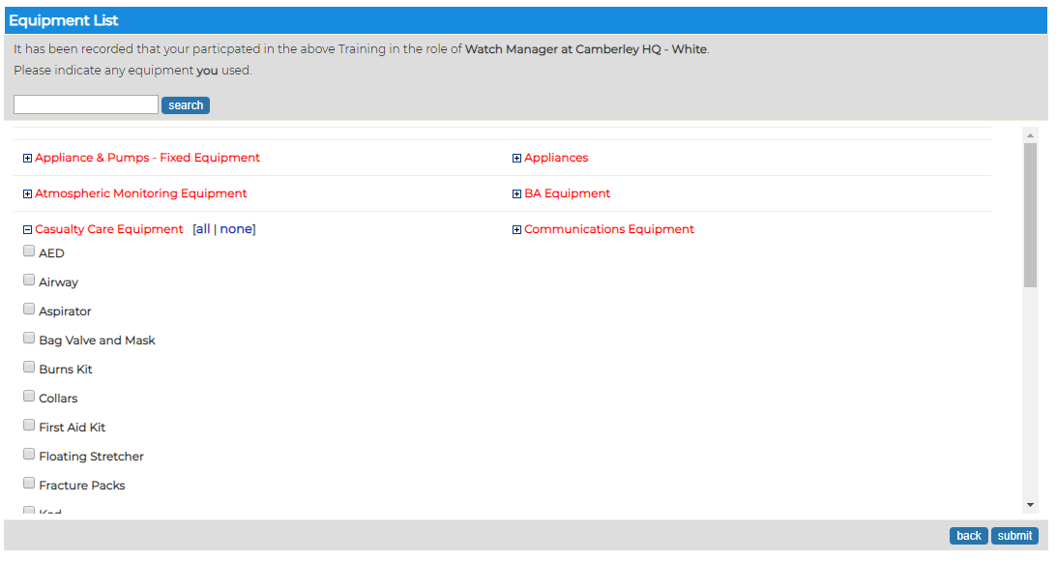
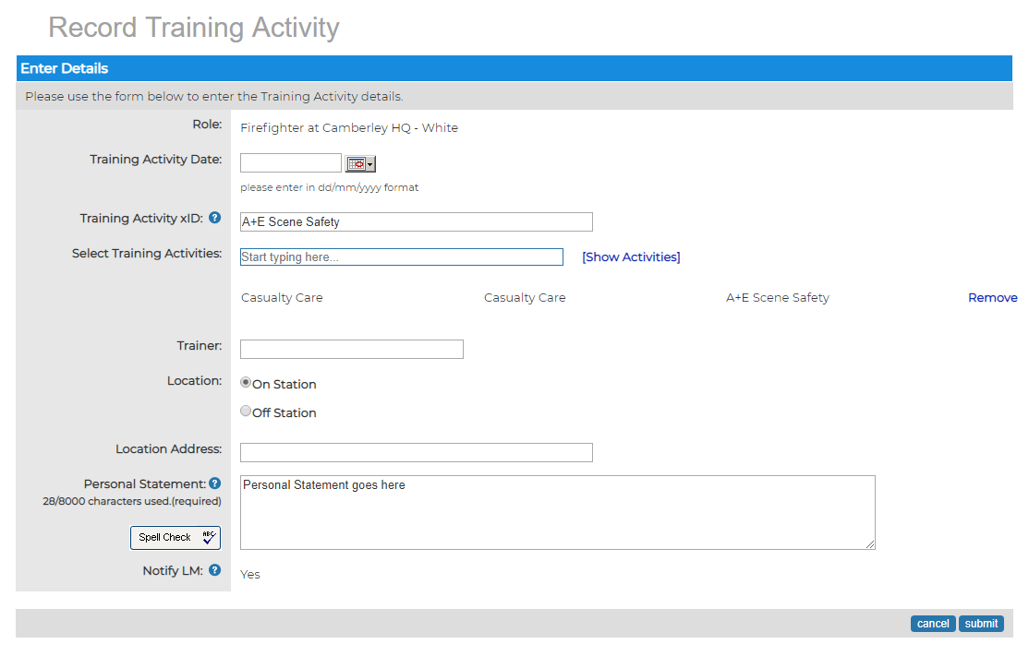
Typical User Journey - Firefighter
Record ad-hoc training event
Populate page
Save
Message sent to an individual’s Line Manager to review
Evidence
Supports attachments
Supports equipment used

Slide 6
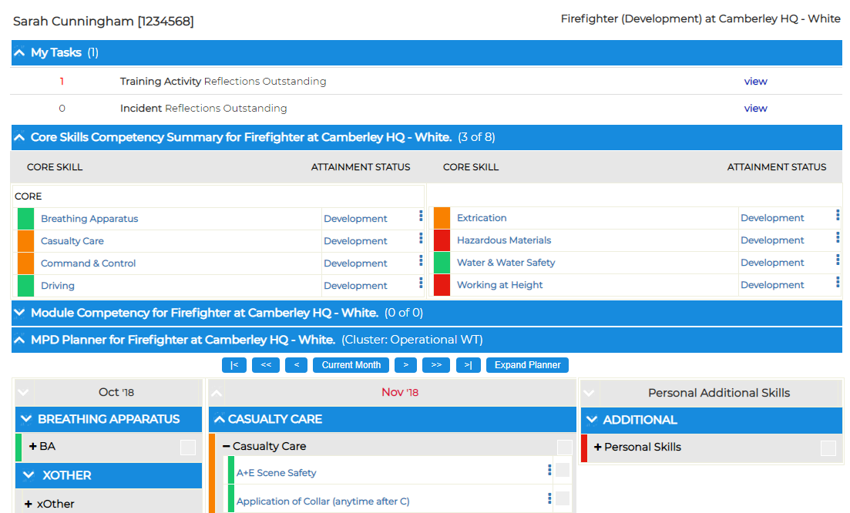
Typical User Journey - Firefighter
Record Training Reflection
Similar process for incident reflection
Incident reflections can contribute towards competency - Switchable option

Slide 7
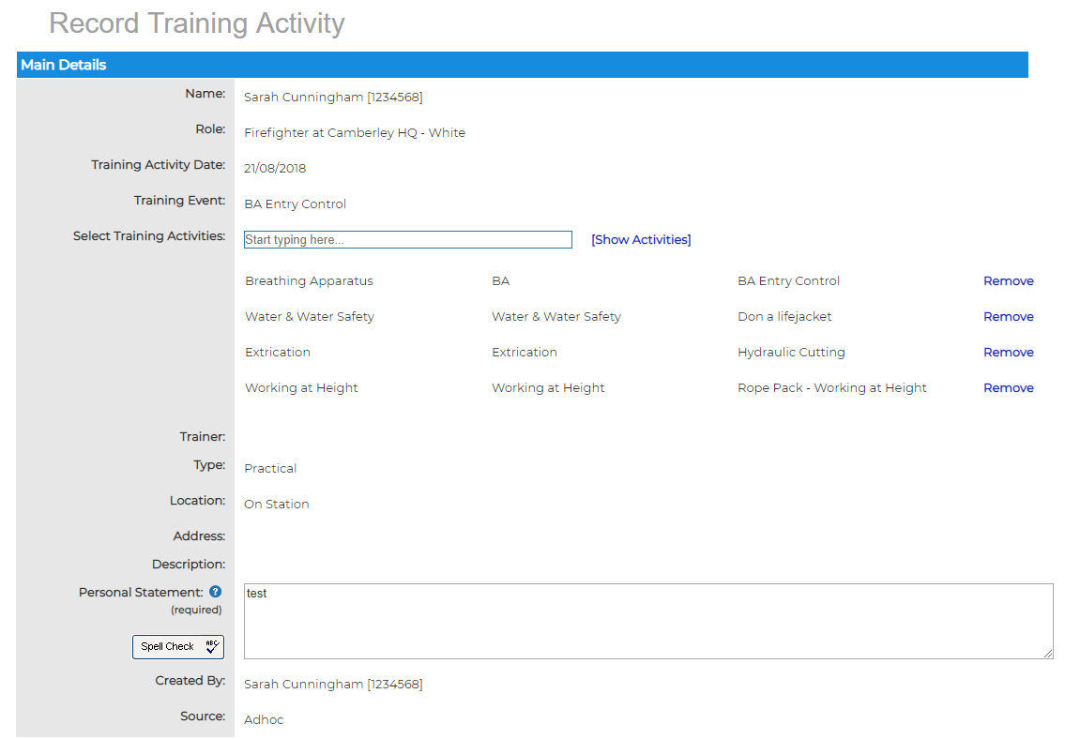
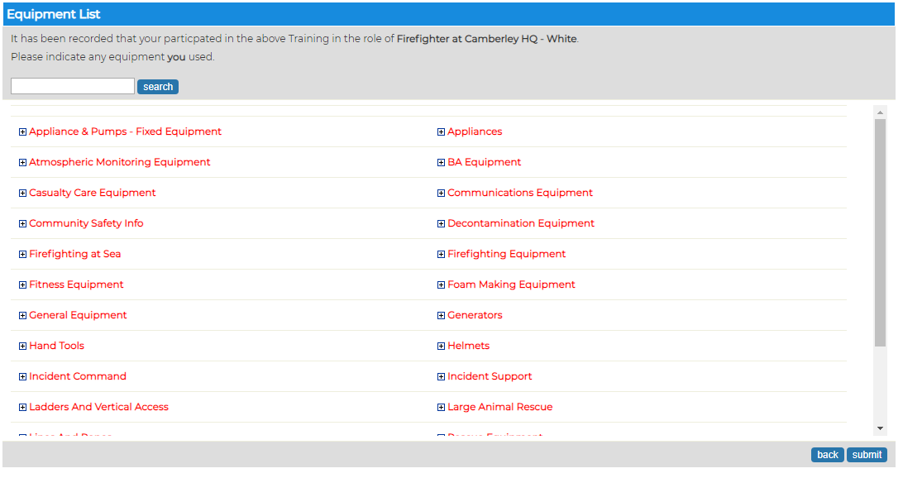
Typical User Journey - Firefighter
Record Training Reflection
Similar process for incident reflection
Incident reflections can contribute towards competency - Switchable option

Slide 8
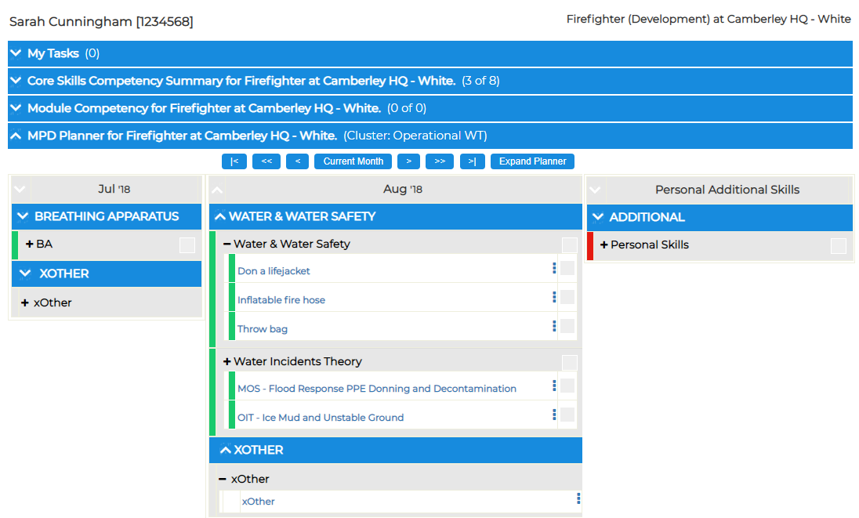
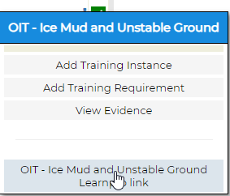
Typical User Journey - Firefighter
Perform e-Learning Assessment
Dashboard
Select e-Learning assessment from planner

Slide 9
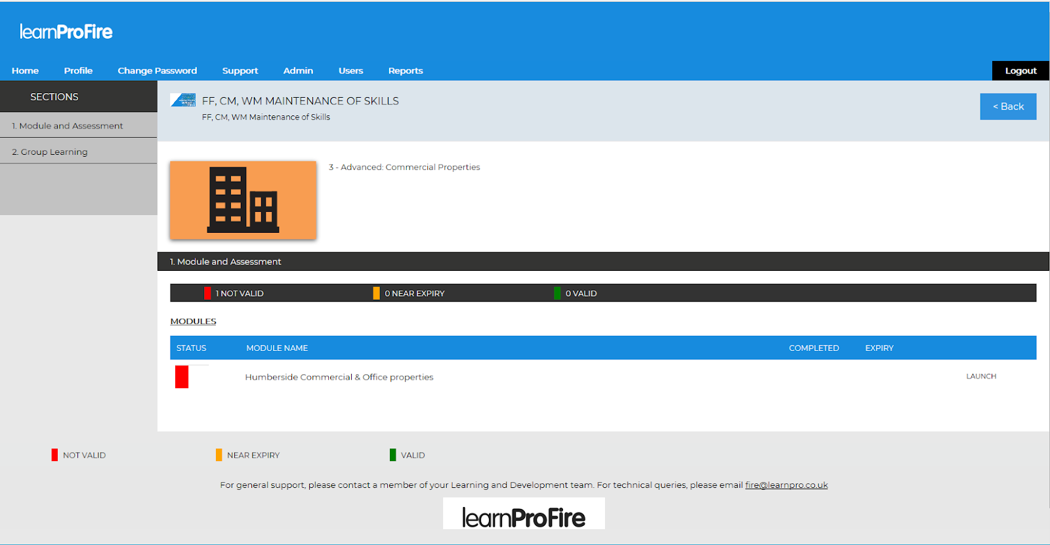
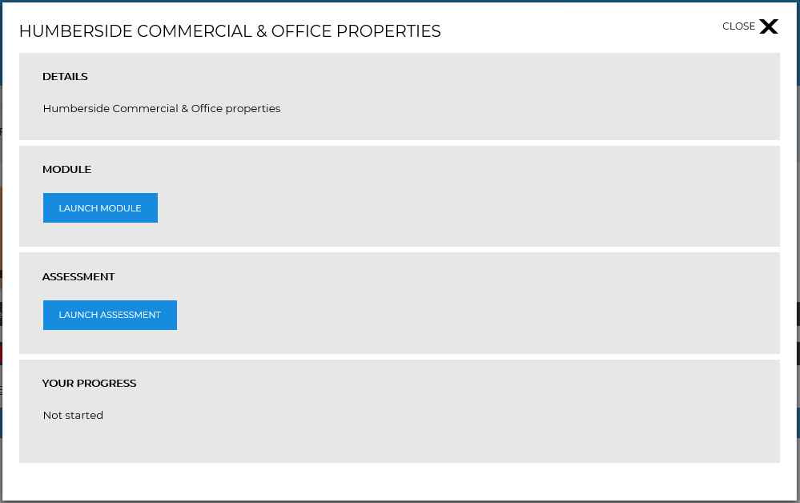
Typical User Journey - Firefighter
Perform e-Learning Assessment
Launch assessment

Slide 10
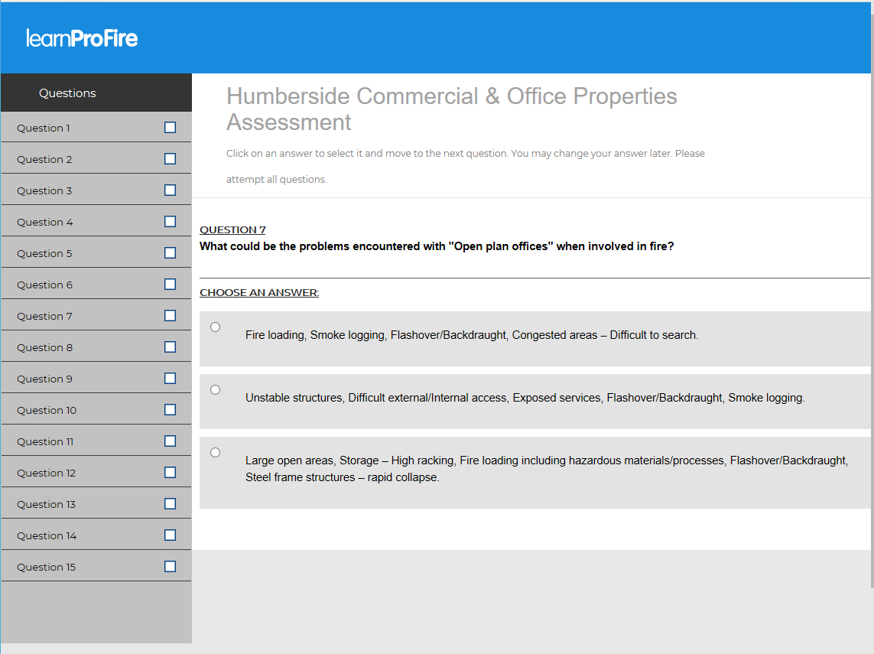
Typical User Journey - Firefighter
Perform e-Learning Assessment
Perform assessment
If assessment successful individuals planner will be updated automatically

Slide 11
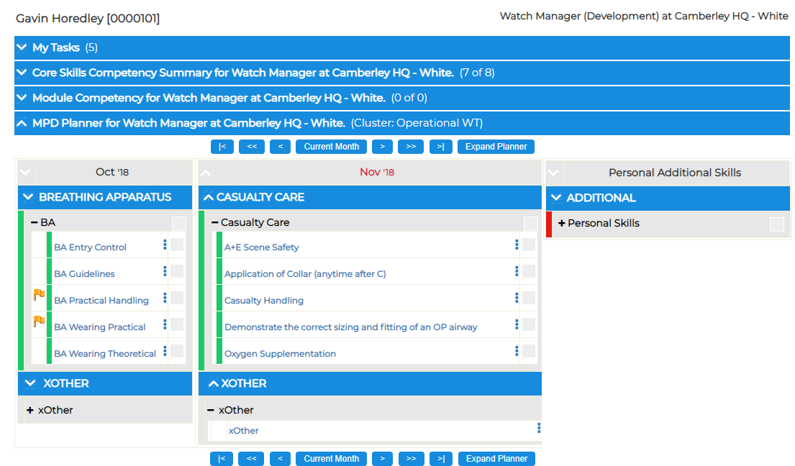
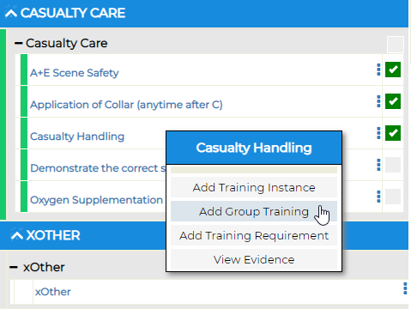
Typical User Journey - Manager
Record group training event
Dashboard
Select group activity / activities from planner

Slide 12
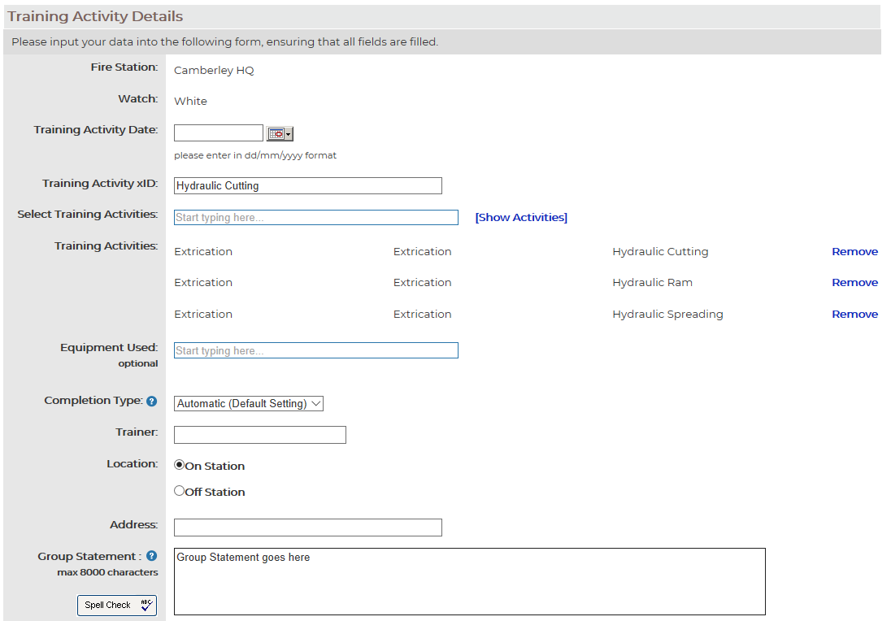
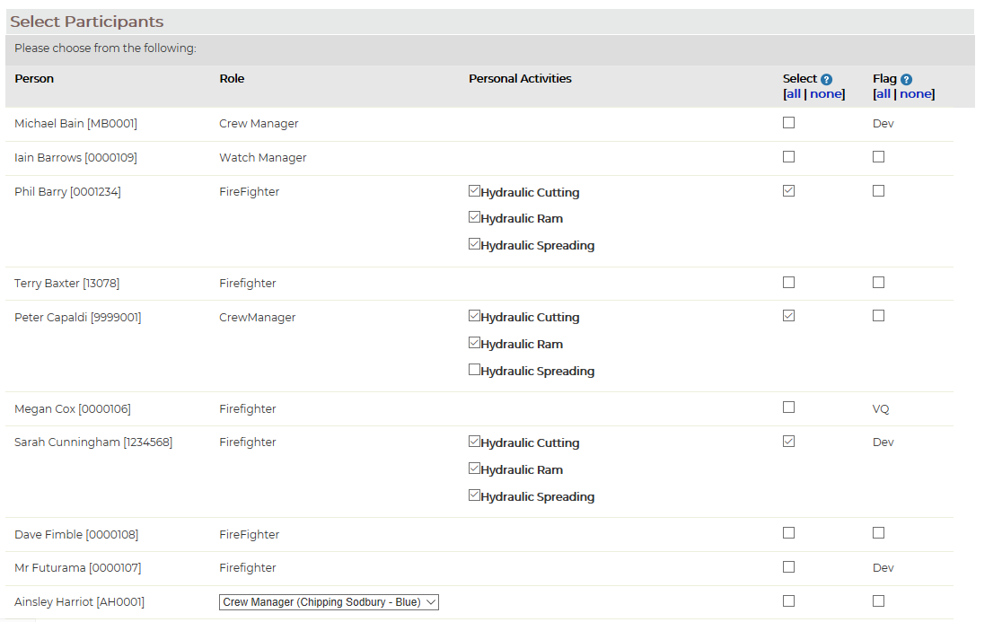
Typical User Journey - Manager
Record group training event
Populate page
Select completion type: manual or automatic
Select participants
Save
The message is only sent to participants requesting a reflection if the manual completion type is selected

Slide 13
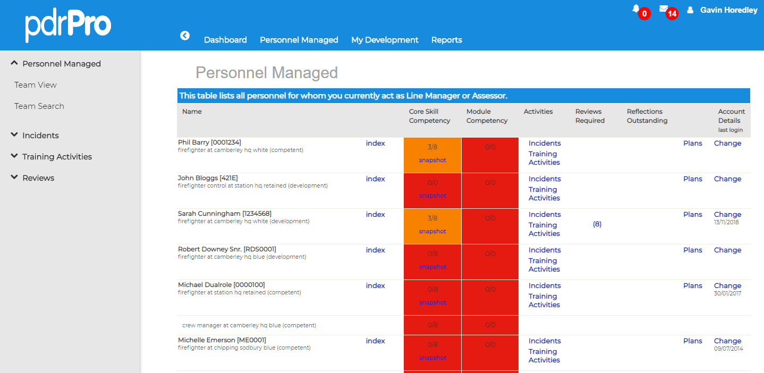
Typical User Journey - Manager
Managing Personnel
Dashboard Overview

Slide 14
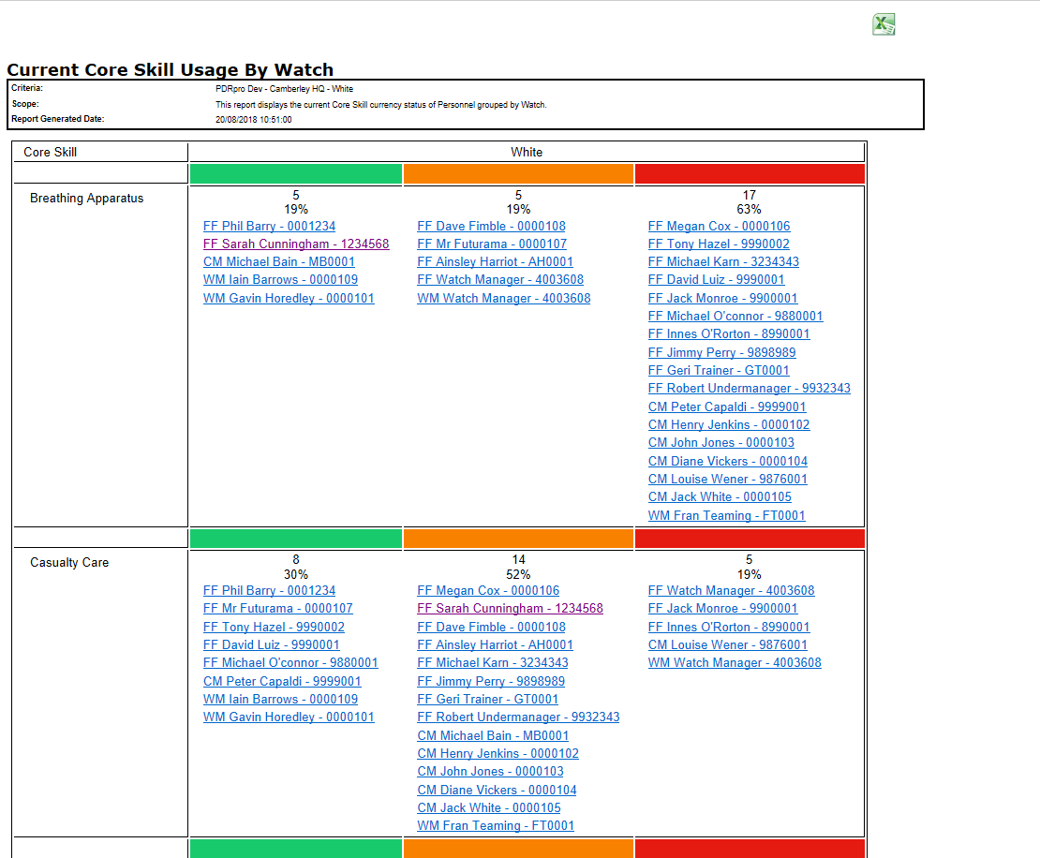
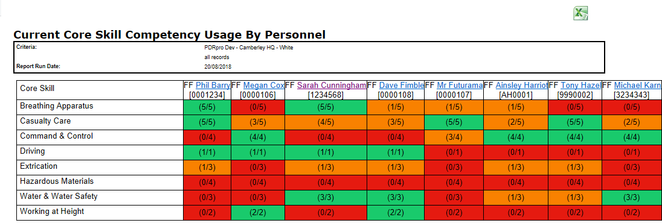
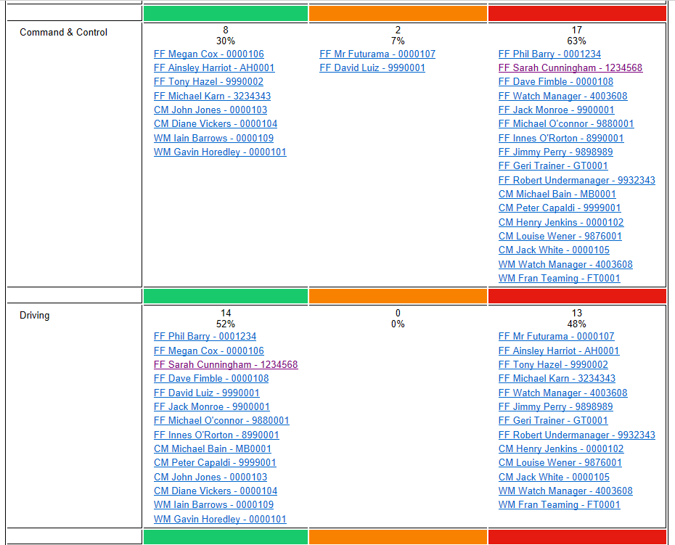
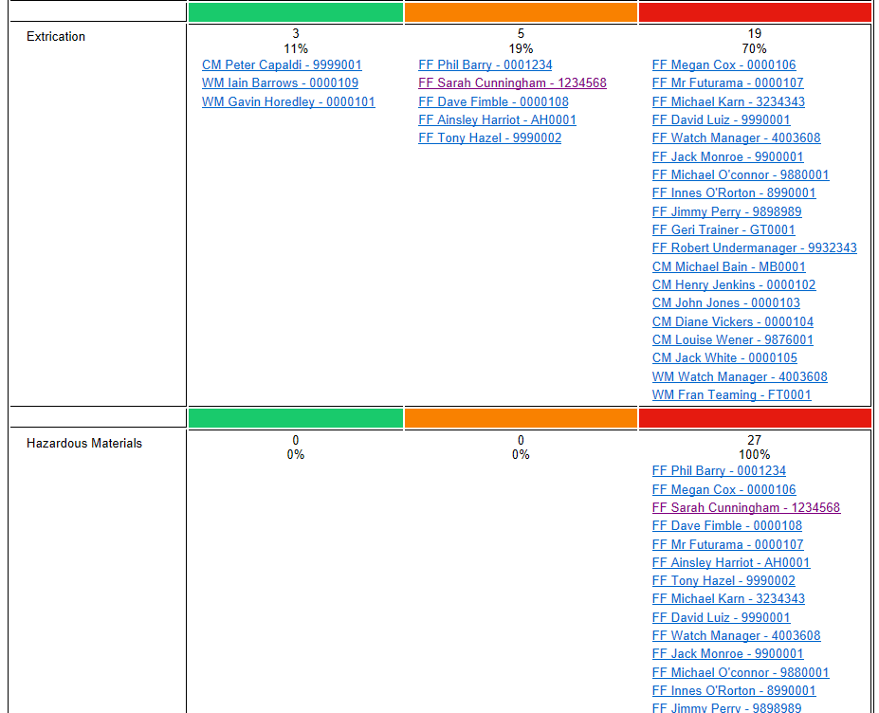
Typical User Journey - Manager
Reporting
Dashboard
Select reports option from top menu bar

Slide 15
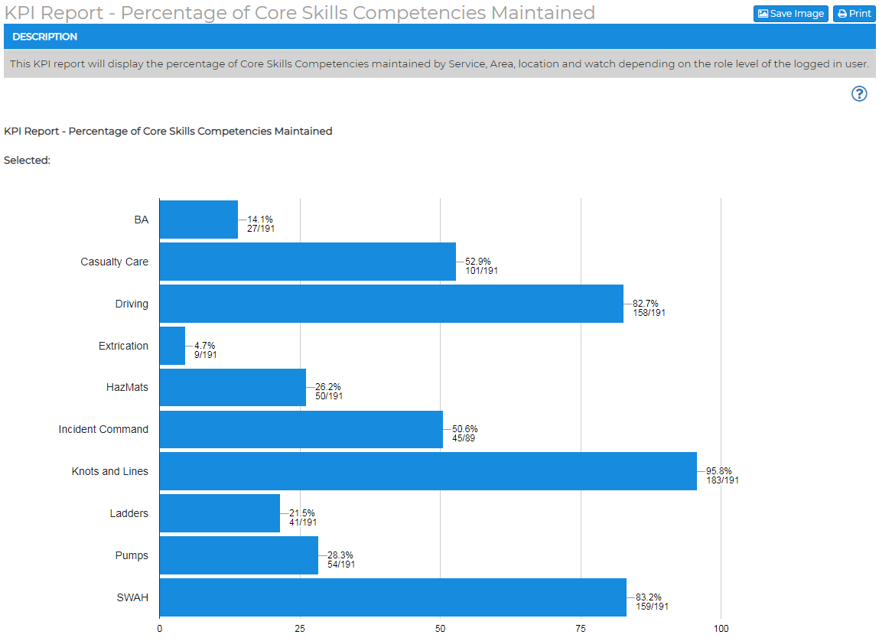
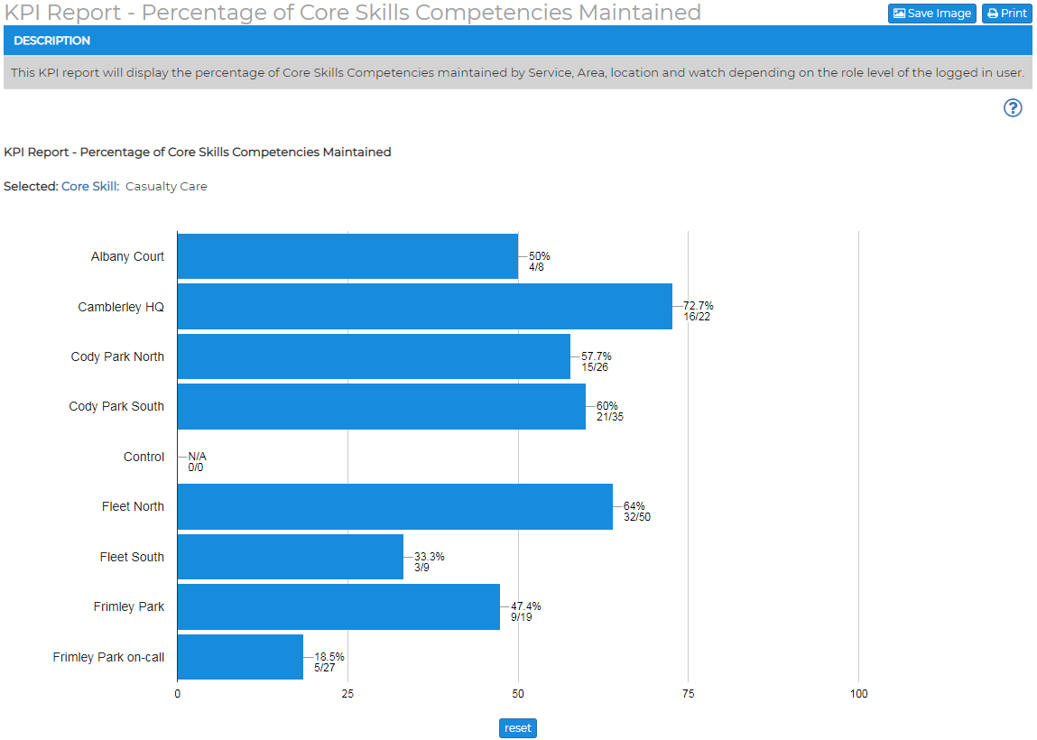
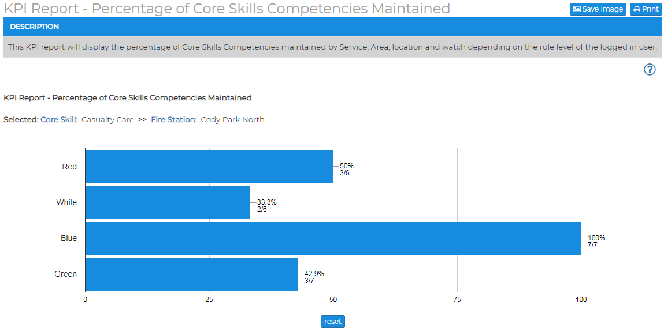
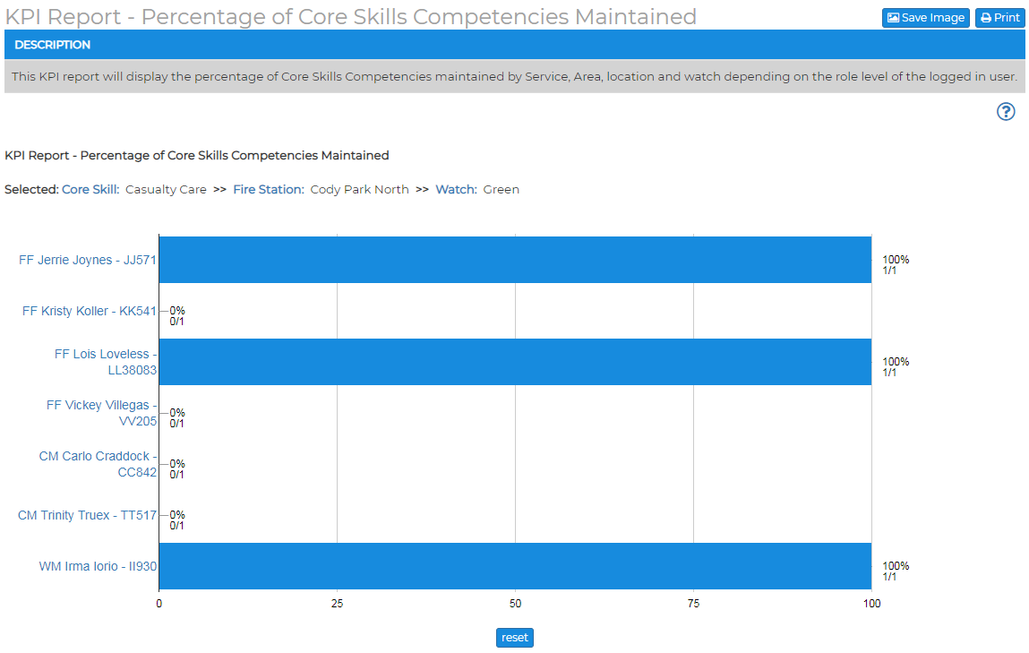
Typical User Journey - Senior Manager
KPI Reports
Fully Customisable KPI Framework
Core skill summary
Click on Bar to Drill Down into Detail

Slide 16
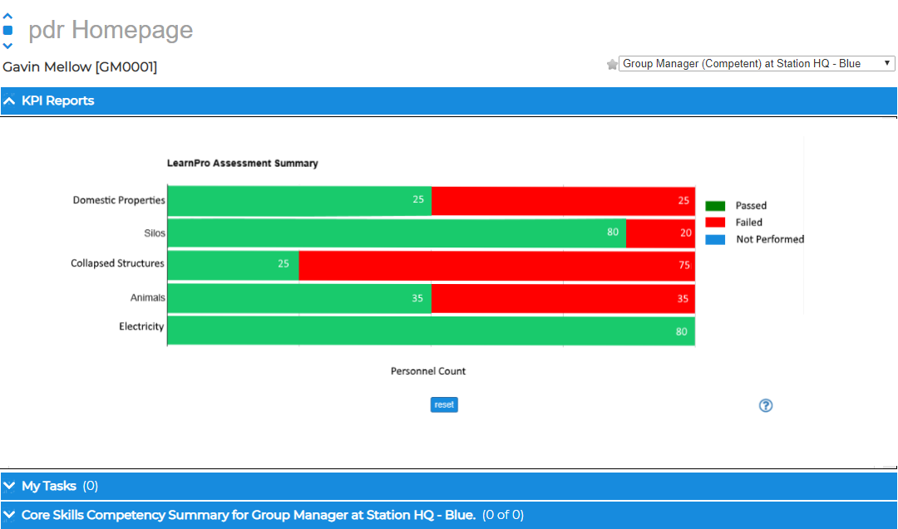
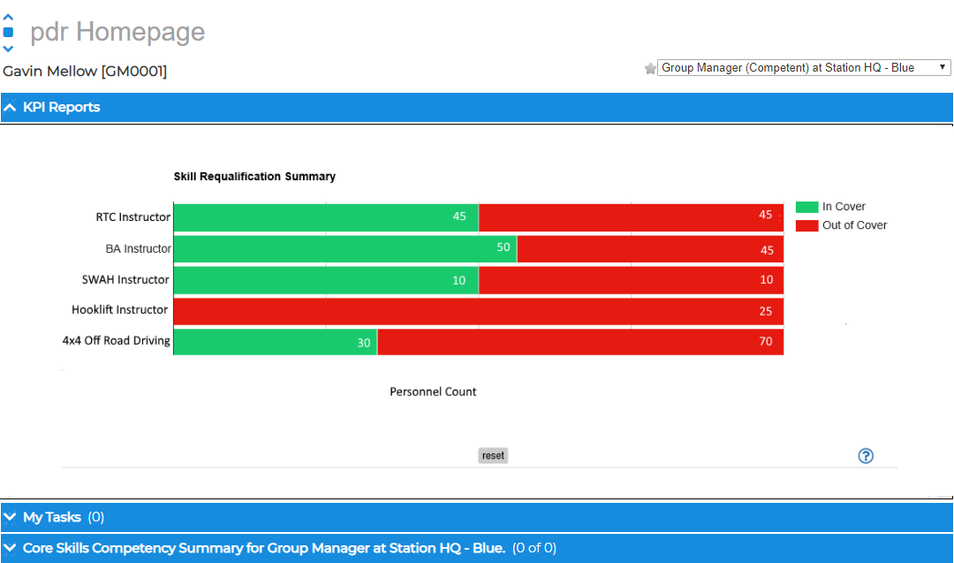
Typical User Journey - Senior Manager
Run KPI Reports
e-Learning assessment summary
Click Bar to drill down data to:
Station view
Watch view

Slide 17
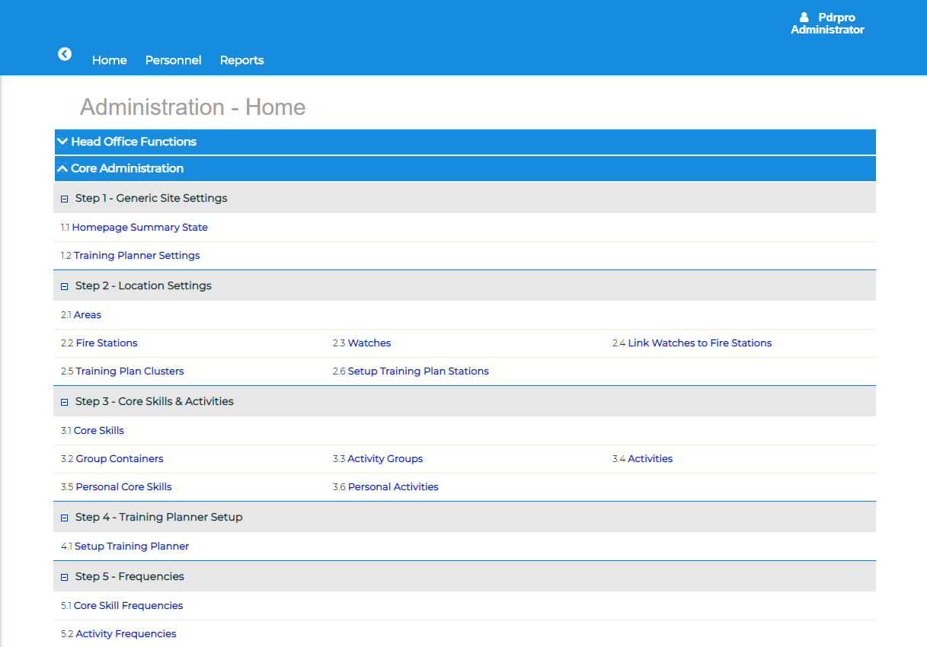
Administrators
System Setup and Configuration

Slide 18
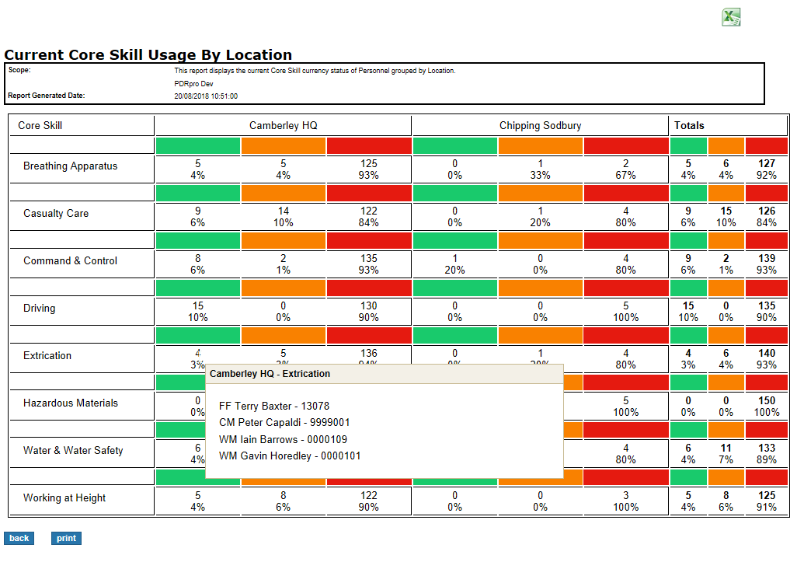
Administrators
Full Scope Reporting
Full Service Wide Reporting by:
Personnel
Watch
Location
Full Reporting for all Modules

Slide 19
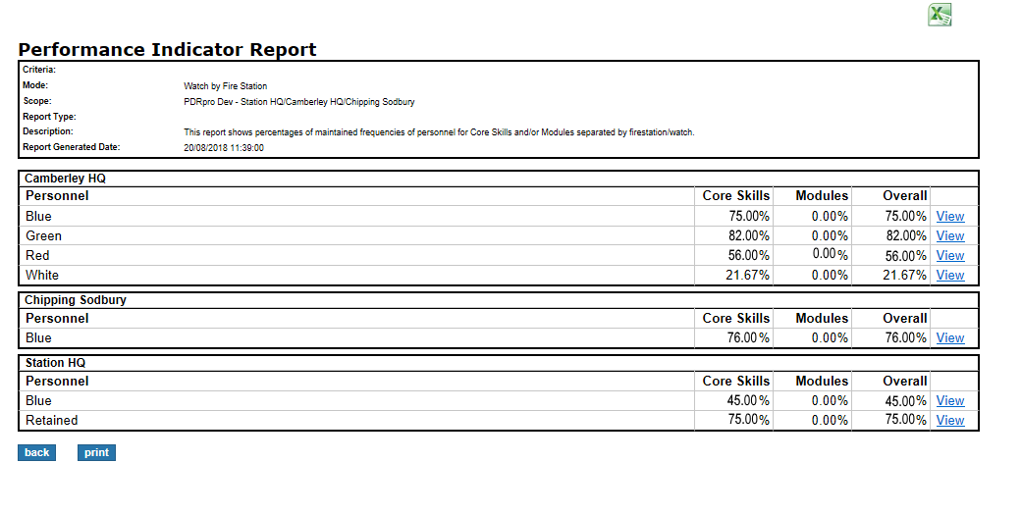
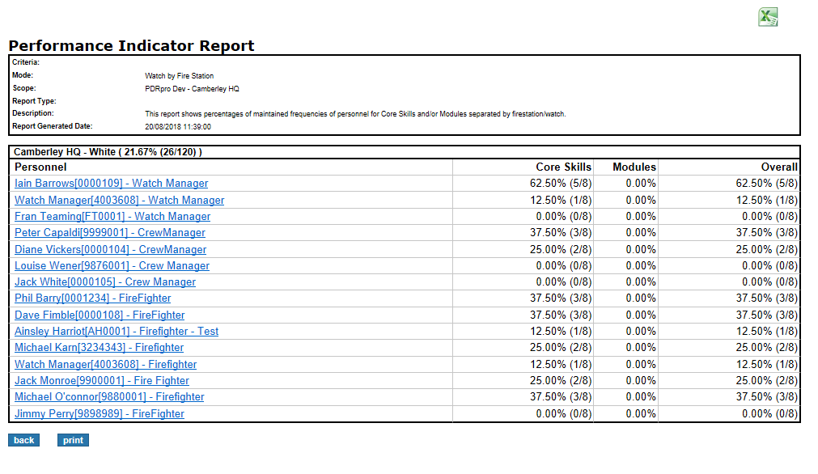
Administrators
Full Scope Reporting
Performance indictor report

Slide 20
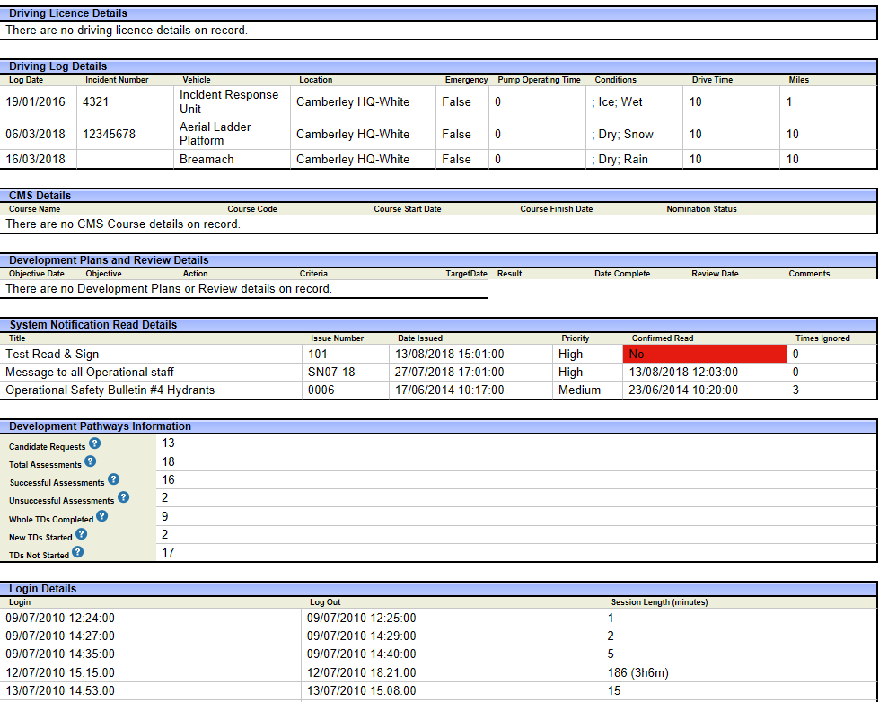
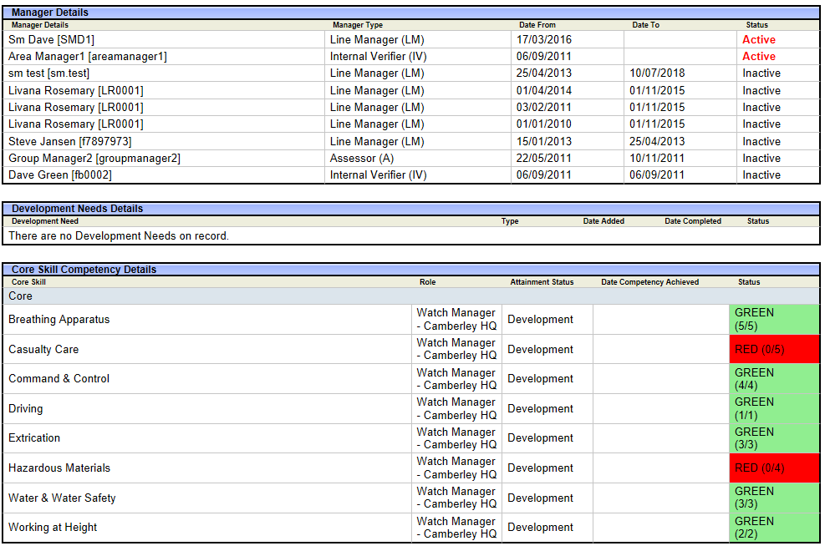
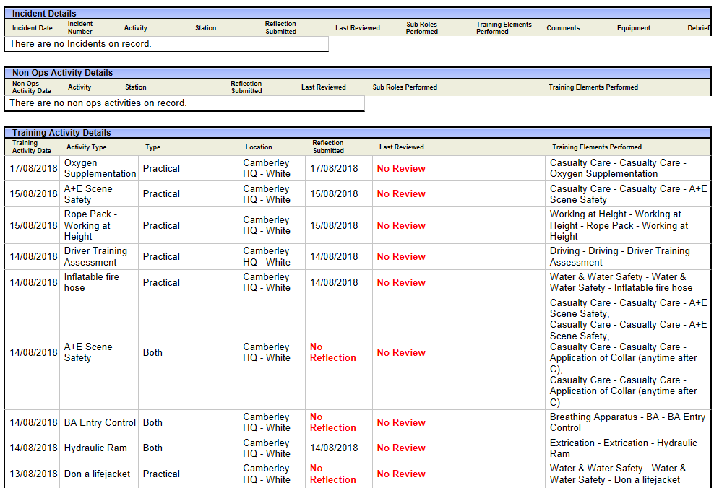
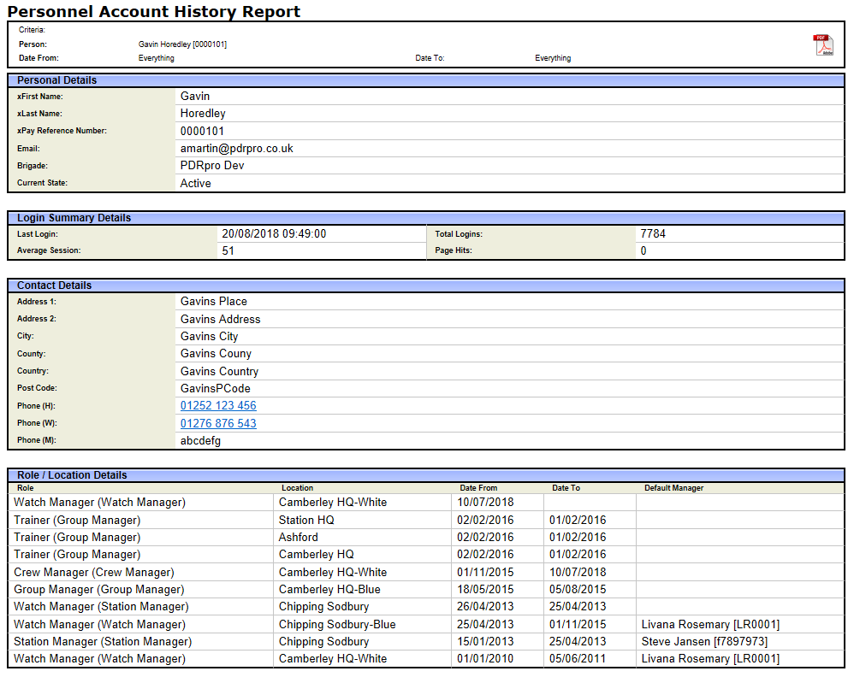
Administrators
Full Scope Reporting
Personal account history report

Slide 21
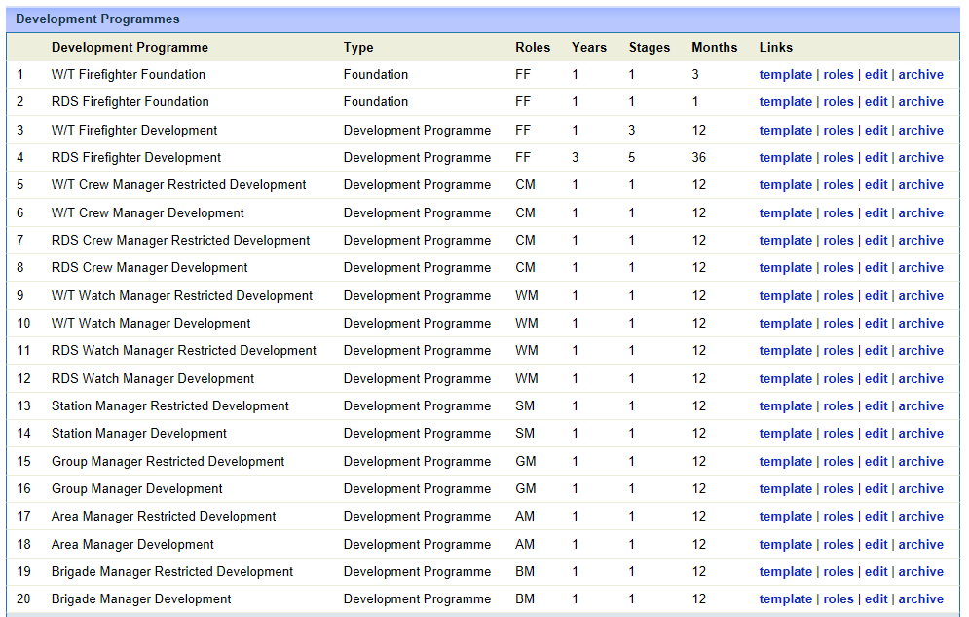
Integrated Modules
Development Pathways
Create fully customisable development templates for both Ops and Non Ops Roles
X number of Years
X number of Stages
X number of months in each stage
X no of modules/activities in each stage
Attach Version controlled Reference Material to pathway Activities
Bulk Assign Personnel to development pathway

Slide 22
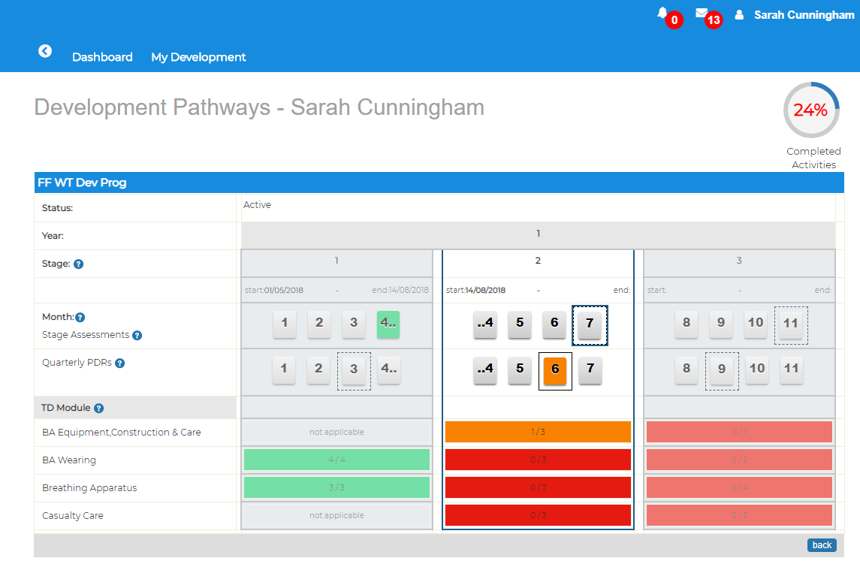
Integrated Modules
Development Pathways
Individuals active development Pathway Development pathway Uses RAG indicators to determine module / activity completion status
Track development progression in real-time against expected completion time frame.
Automatically triggers quarterly manager reviews, and Verifier end of stage assessments

Slide 23
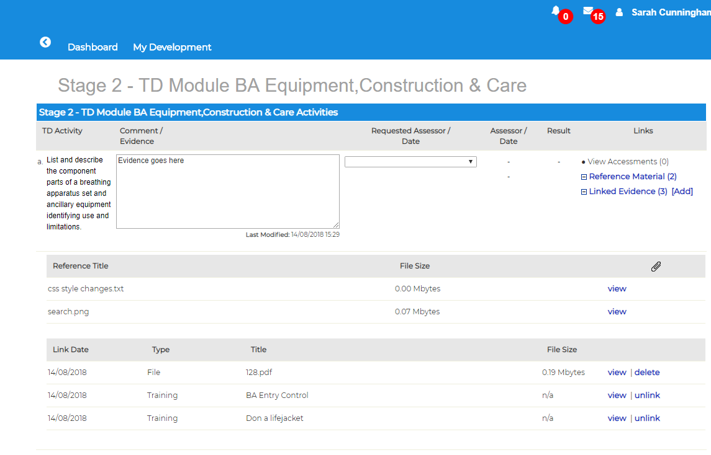
Integrated Modules
Development Pathways
Individual enters evidence :
Text
Attachment(s)
Link to Training / Learnpro activities
LInk to Incidents
Individual requests Assessment
Manager performs activity assessments. (ad-hoc or requested by individual)
Verifier signs off end of stage Assessments and final pathway sign off

Slide 24
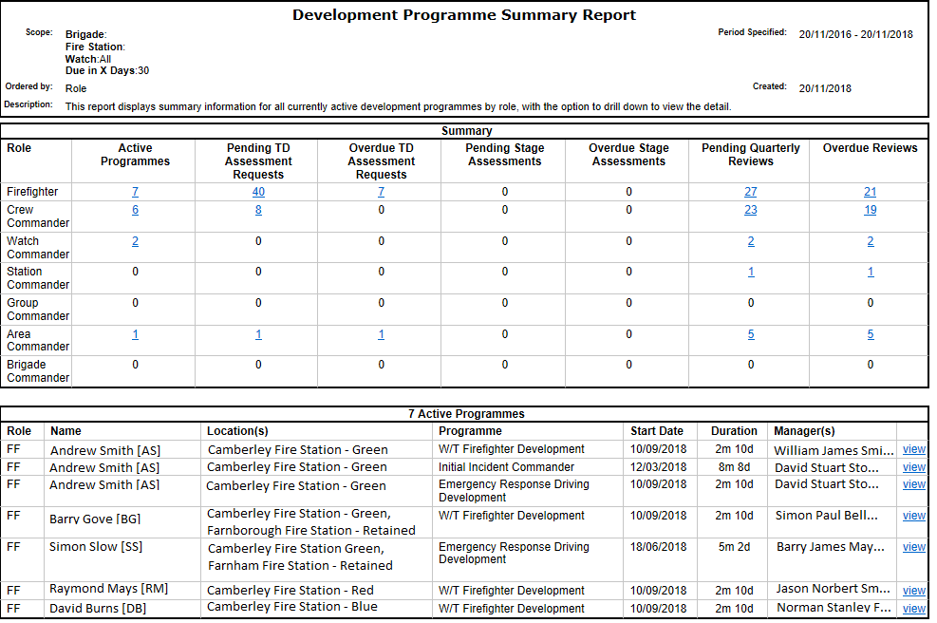
Integrated Modules
Development Pathways
Manage all active development pathways from one summary report

Slide 25
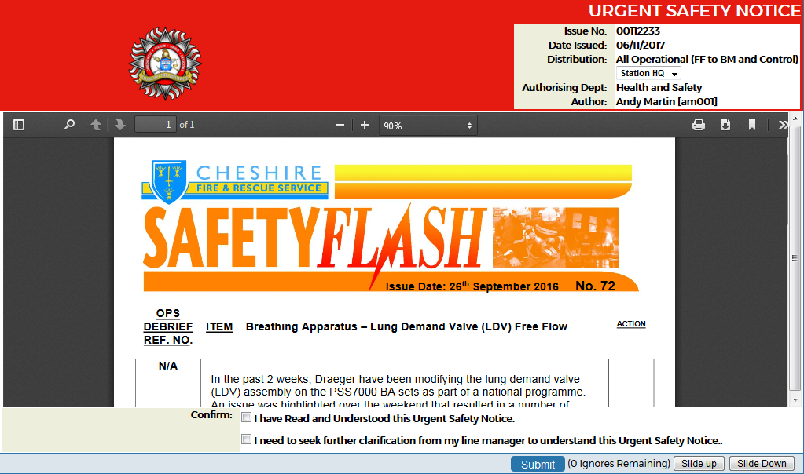
Integrated Modules
Electronic Read and Sign
Create and Issue all types of notices, Eg: Urgent Safety, Ops Alerts.
Read and Sign Functionality
Send to individuals, groups or all
Supports Document links
Attach PDF document to notices
Report on personnel who have read and not read notices

Slide 26
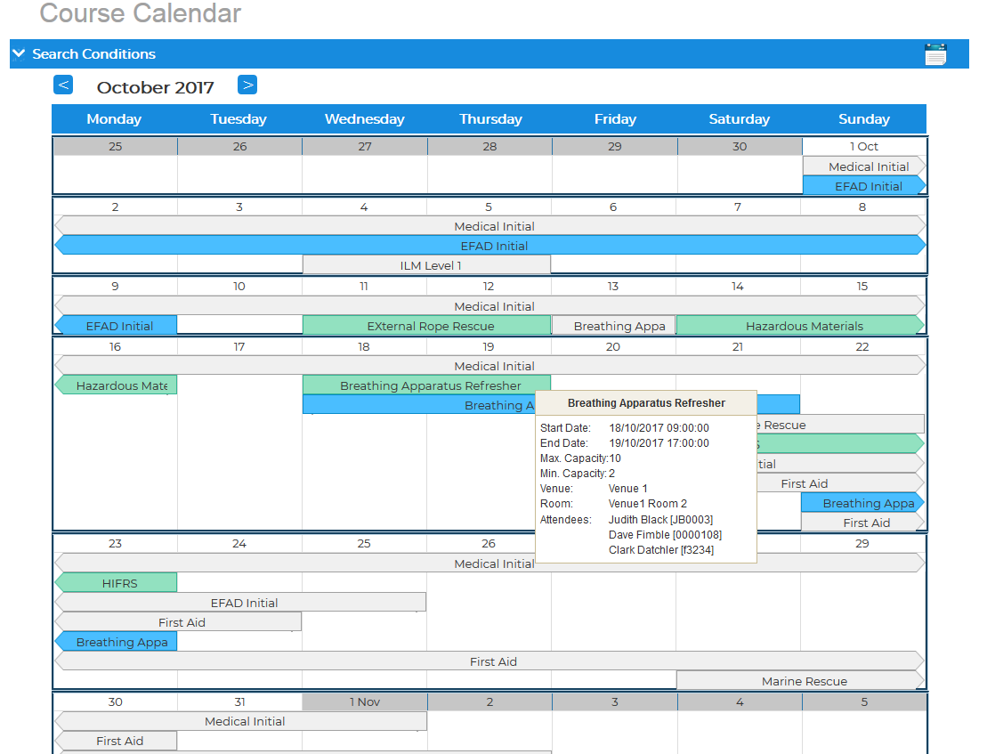
Integrated Modules
Course Management
Calendar based course scheduling and nomination process
Nomination methods:
Admin
TNA process
Team
Self
Course feedback
Integrates with the activity planner
Reporting

Slide 27
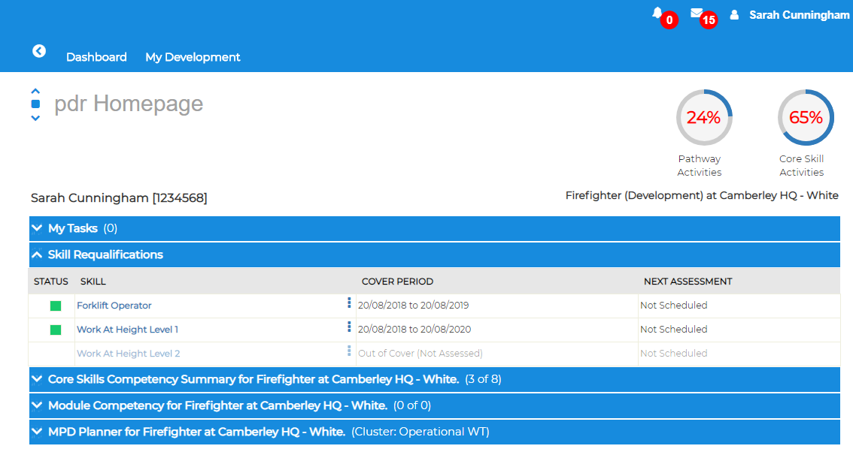
Integrated Modules
Skill Requalifications
Manages skill requalification process
3 Tier certification process
Operators
Operator Assessors
Assess Assessors
Supports certificate / assessment upload
Integrated into CMS system

Slide 28
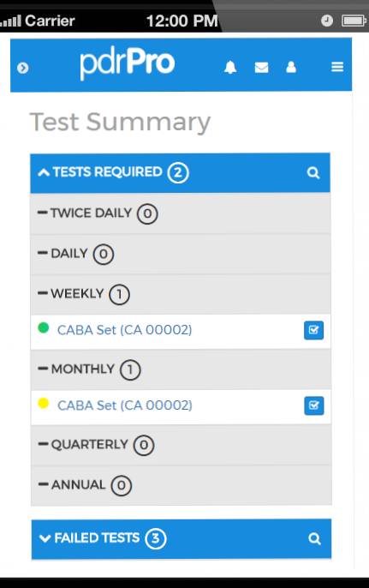
Integrated Modules
Equipment Testing
Add tests directly from mobile
Daily, Weekly, Monthly, Quarterly, Yearly
Includes PPE
Testing can contribute to training activities

Slide 29
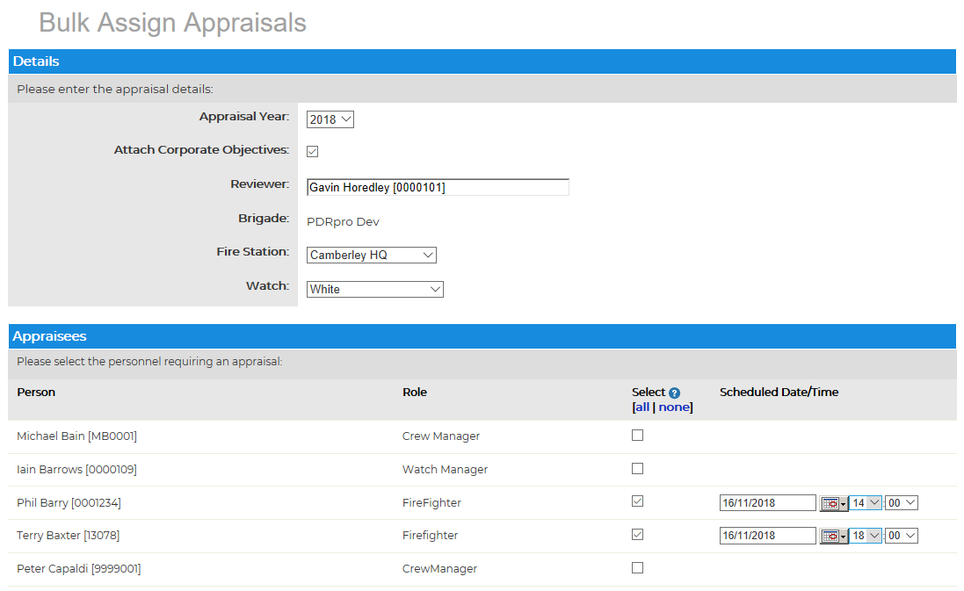
Integrated Modules
Appraisals
Schedule & record periodic appraisals
4 Stage process
Create
Pre-appraisal
Schedule
Perform
Supports interim Appraisals

Slide 30
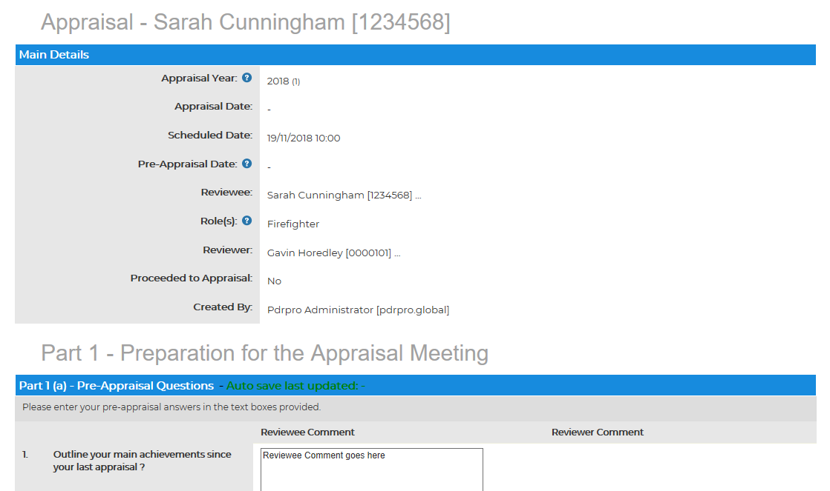
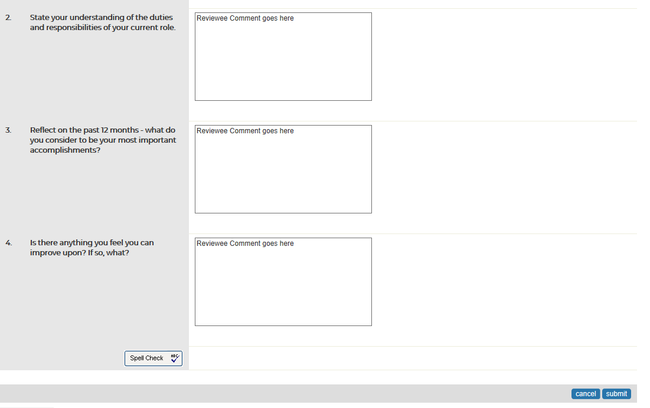
Integrated Modules
Appraisals
Individual completes Pre-Appraisal Questionnaire
Pre-Appraisal Questions configurable in admin section
Support for Corporate Objectives

Slide 31
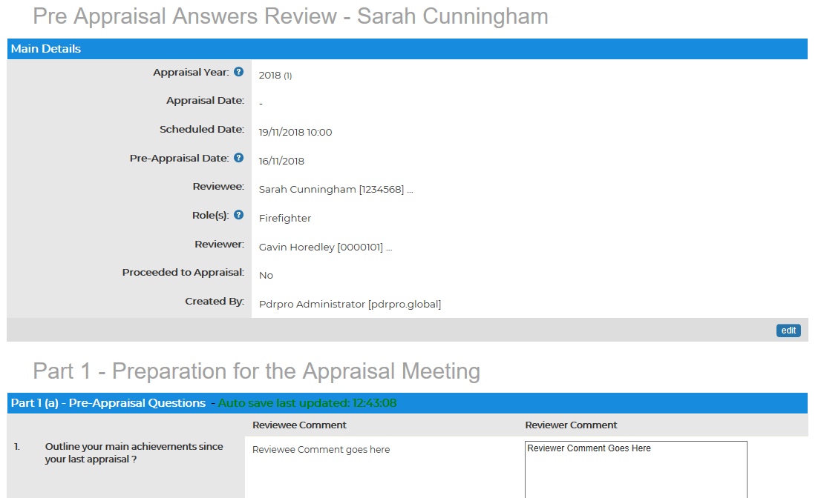
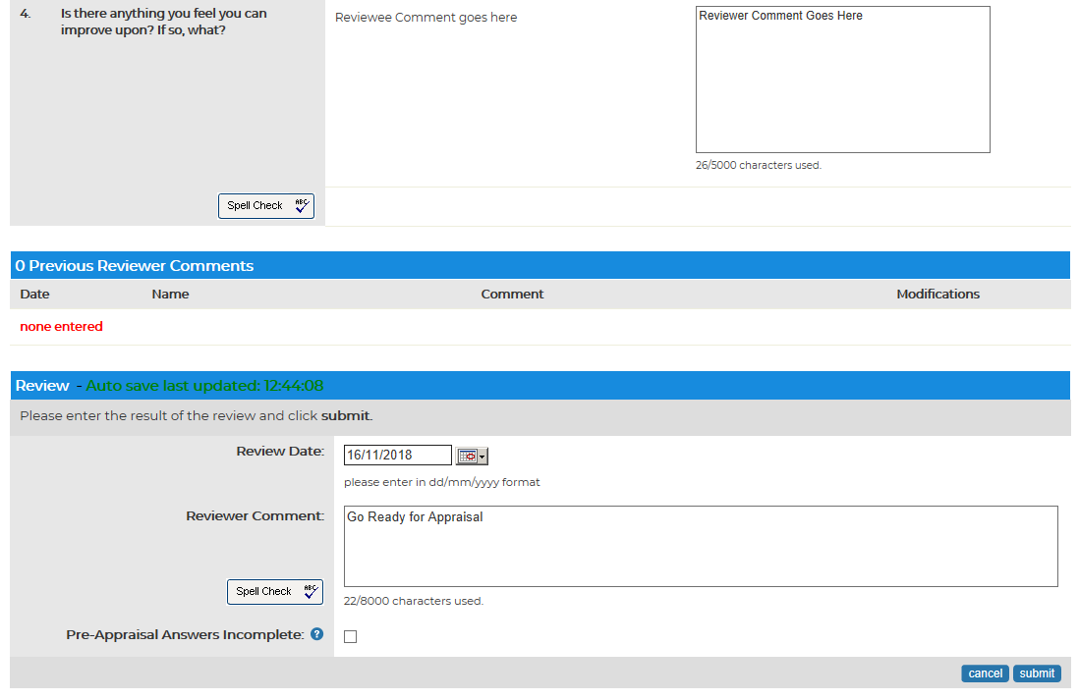
Integrated Modules
Appraisals
Manager reviews Pre-Appraisal Answers

Slide 32
Integrated Modules
Appraisals
Perform Appraisal
CPD eligibility check

Slide 33
Integrated Modules
Appraisals
Appraisals Summary Report

Slide 34
pdrPro Web API Service
Providing data exchange between other systems using https requests
Fully authenticated access
JSON Web Tokens
Export data
using GET Methods
Core Skill Competency Data
LearnPro Data
Import data
using POST Methods
Personnel role/location updates
Manager Updates
Data formats supported
JSON,XML

Slide 35
Integrated Modules
Operational Assurance
Response Manager:
Create OA assessment form(s)
OA Team: Review completed OA forms
Raise and send out
PINs
OA Alerts
GPNs to Actioning Manager(s)
Actioning Manager:
Resolve & Update PIN’s
OA Team: Review and close off resolved PINs

Slide 36
Integrated Modules
Operational Assurance
Response Manager
OA Form Creation

Slide 37
Integrated Modules
Operational Assurance
OA Team
Review & Update completed OA forms
Select Actioning Manager(s ) and Generate Actions

Slide 38
Integrated Modules
Operational Assurance
Actioning Managers
Complete the required actions

Slide 39
Integrated Modules
Operational Assurance
Reporting

Slide 40
Integrated Modules
Non-Operational Staff Dashboard

Slide 41
learnPro Overview

Slide 42
Learning Management System
The LMS is Bespoke system designed specifically for the Fire
Allows comprehensive management and distribution of learning including reporting to show compliance, assessment scores, and completion dates of learning. It handles programmes and pathways of learning together with a revalidation system
It has built in authoring tools to create separate assessments, advanced e-learning modules that are mobile enabled, video streaming and sharing capability regionally and Nationally

Slide 43
Widest Selection of Fire Related e-Learning Course and Assessments
Core Skill Videos, Courses and Assessments
Firefighter Development Programme Courses and Assessments
Management and Mandatory Courses for all Staff
Convert your PowerPoints into e-Learning Courses - Conversion tool
Every Subject Covered from Incident Command to BA

Slide 44
Content Management System
FRS specific system for sharing content
32 services share content - share video, courses and assessments
Totally integrated into PDRpro
Form groups to share specific content and manage version control

Slide 45
LAB Advanced Authoring System
Create Responsive e-learning for any device - Authoring your own courses
Lab advanced; Inbuilt authoring tool, online for ease of use, sharing and ease of customising shared content
Manage projects, collaborate, build themes, add and manage images, video and interactions
Lab advanced is mobile friendly for Tablets and Phones

Slide 46
Powerful Compliance Reporting
Dashboard for watch managers with ability for admin to set up each station mandatory training
Revalidation automatically manages expiry and alerts L&D and Line Managers
Wide range of reports
Export and Integrates Reports with HR
Sync software available

Slide 47
Platforms App and
Authoring System
Create any form or decision tree
Authored via learnPro
Create any Form and Report Back
Add SOPS and images
Add videos from learnPro LMS and stream directly on all devices
Services creating Apps for Safe and Well, Home Visits, Operational Checklists, Incident Monitoring

Slide 48
Summary
One integrated system for Firefighters and Management
Core skills
Planner
eLearning
Course management
Development pathways
KPI’s and reports
API to integrate with other systems
Compatible system for all other types of employees
Development pathways and apprenticeships
Planner
eLearning
Notices
Extensive reports and KPI’s
Can I see how many firefighters are in frequency and trained on BA and am I confident that there is a plan to keep people safe?
Integrates with other systems, API

